Slide 1
新人週報
報告人:林萬郝
2022/06/01-2022/06/15

Slide 2
AP & LP Quartz種類

Slide 3
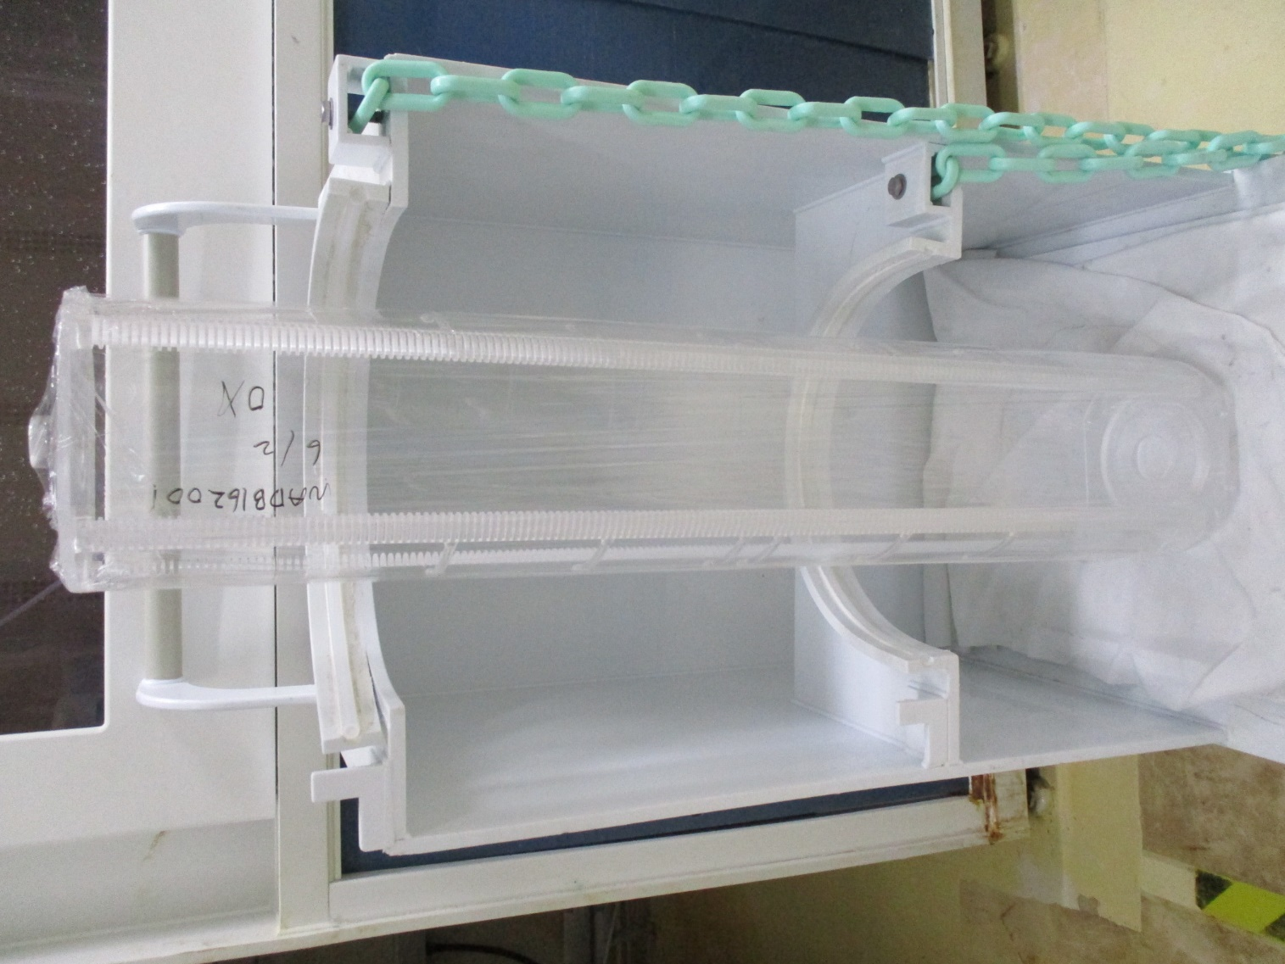
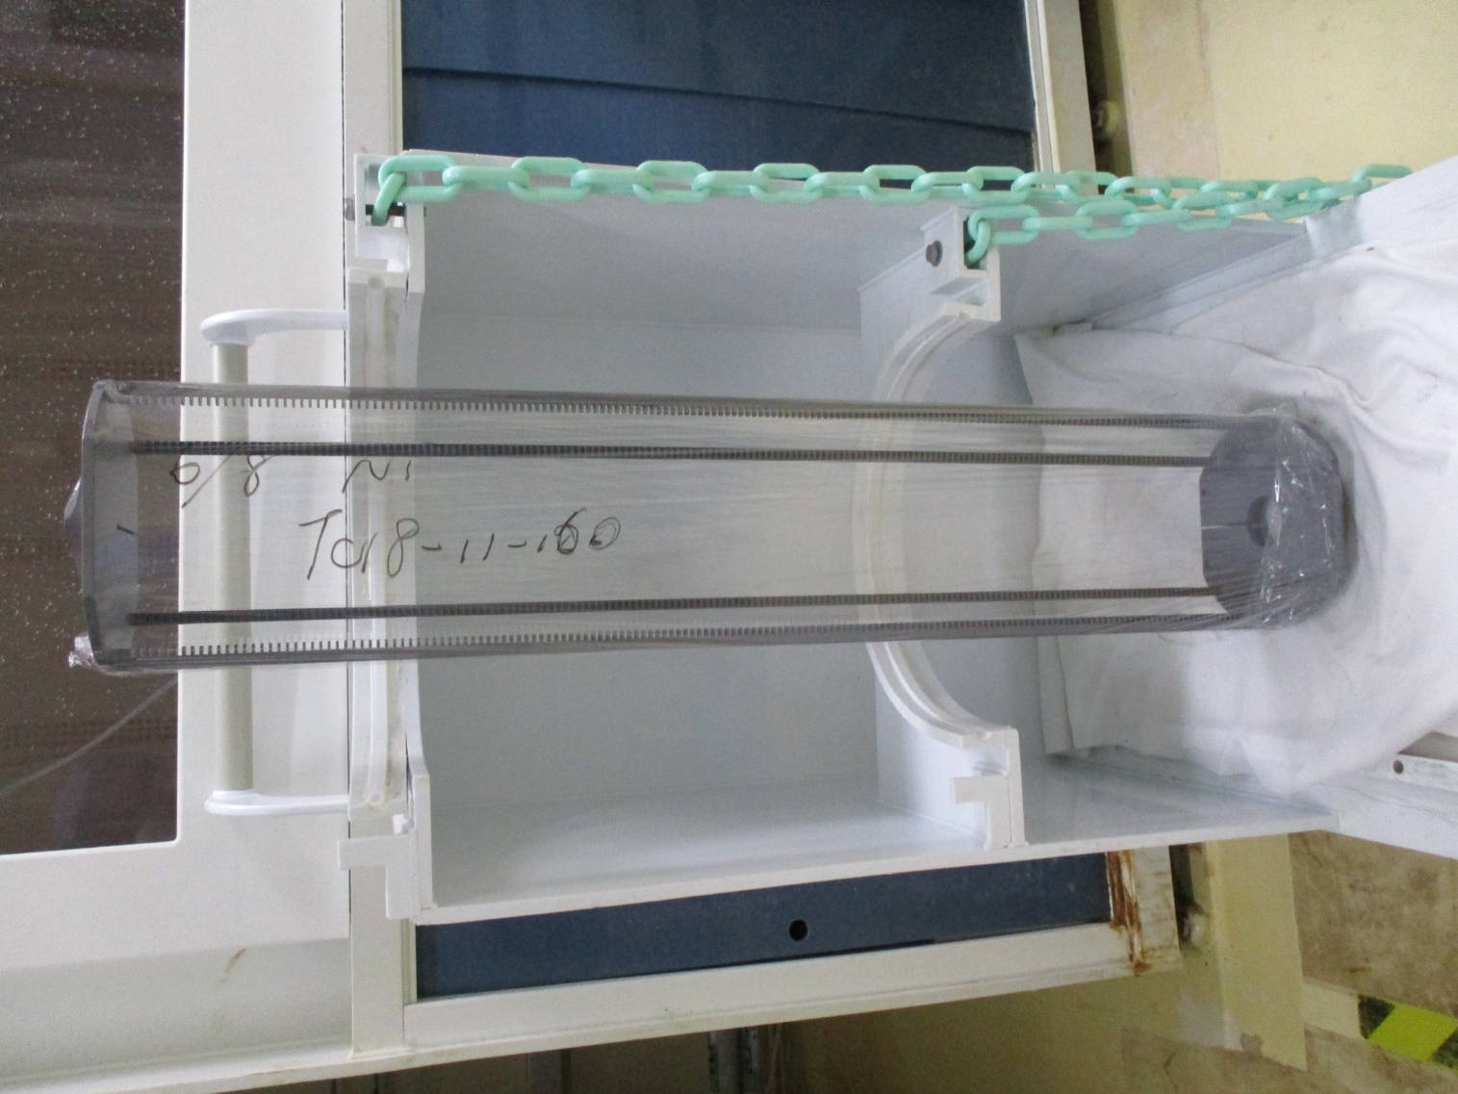
Boat
一般Oxide
LP管(SiC)

Slide 4
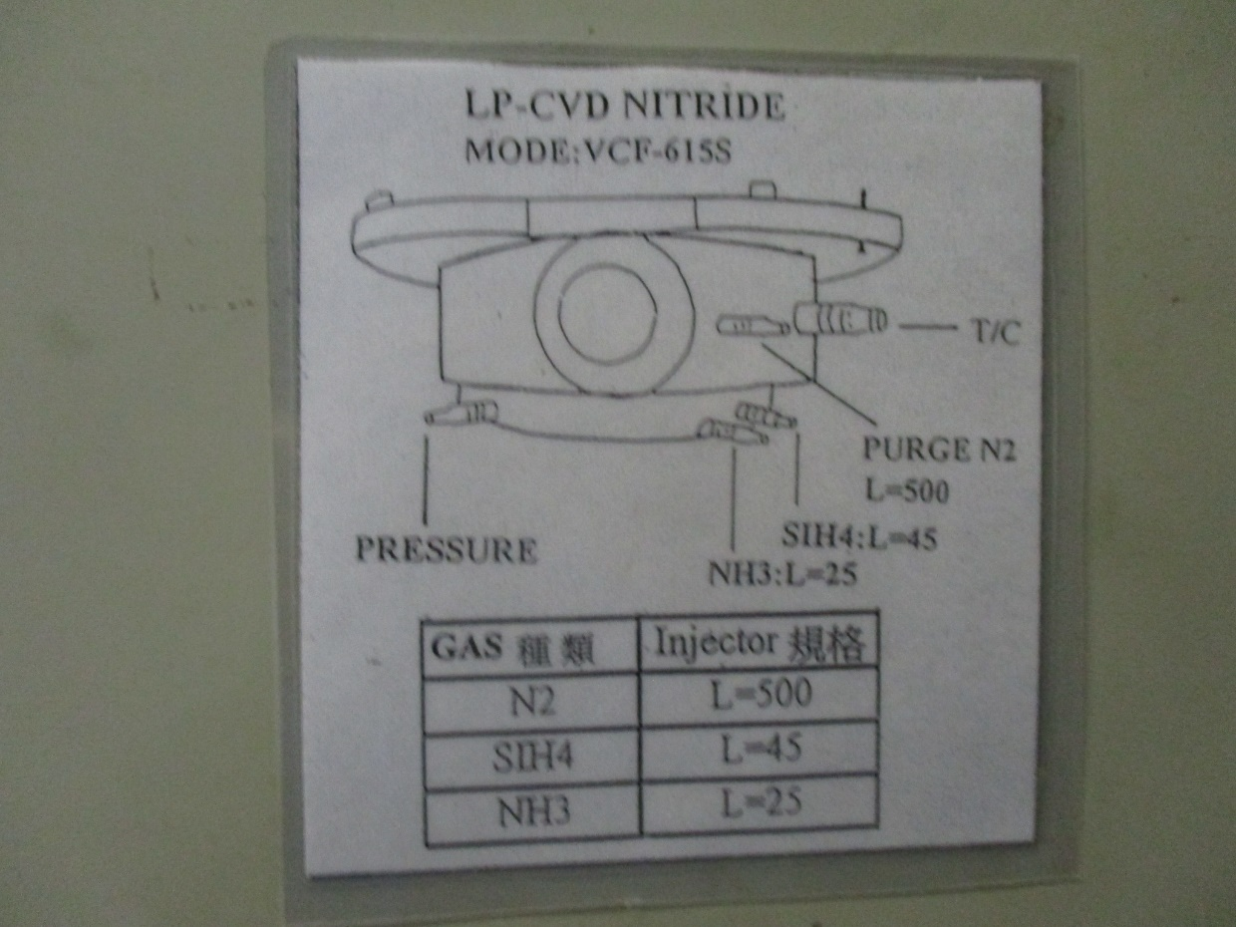
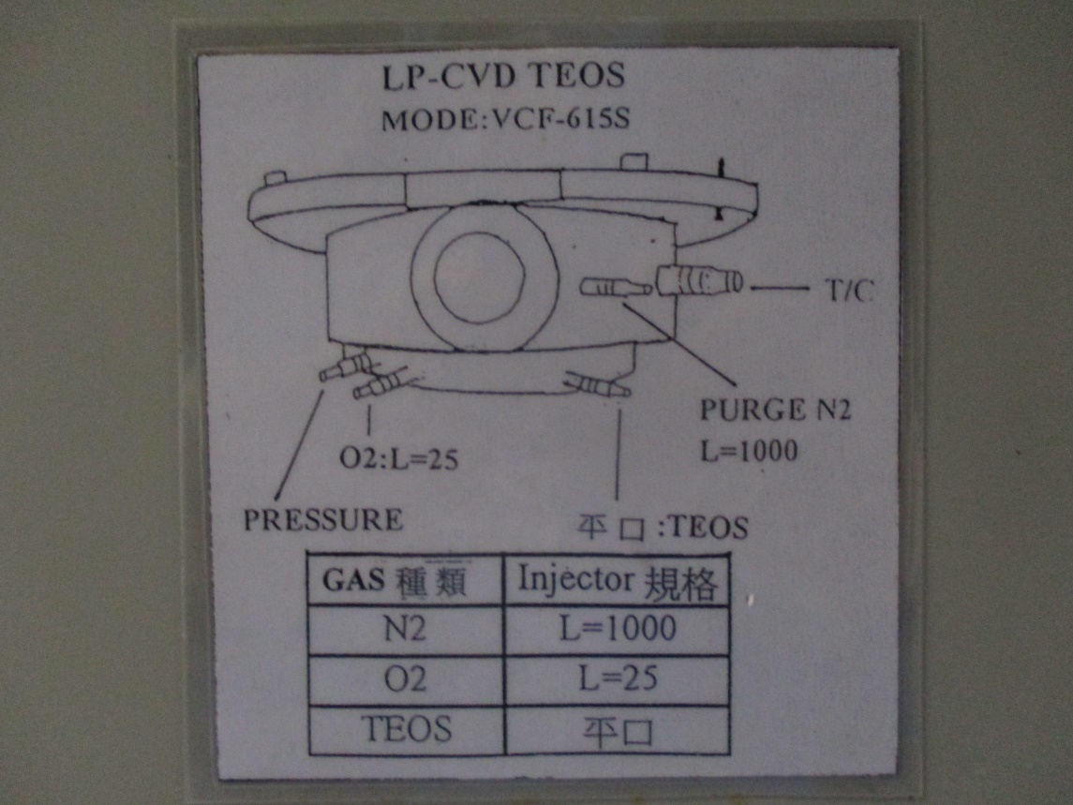
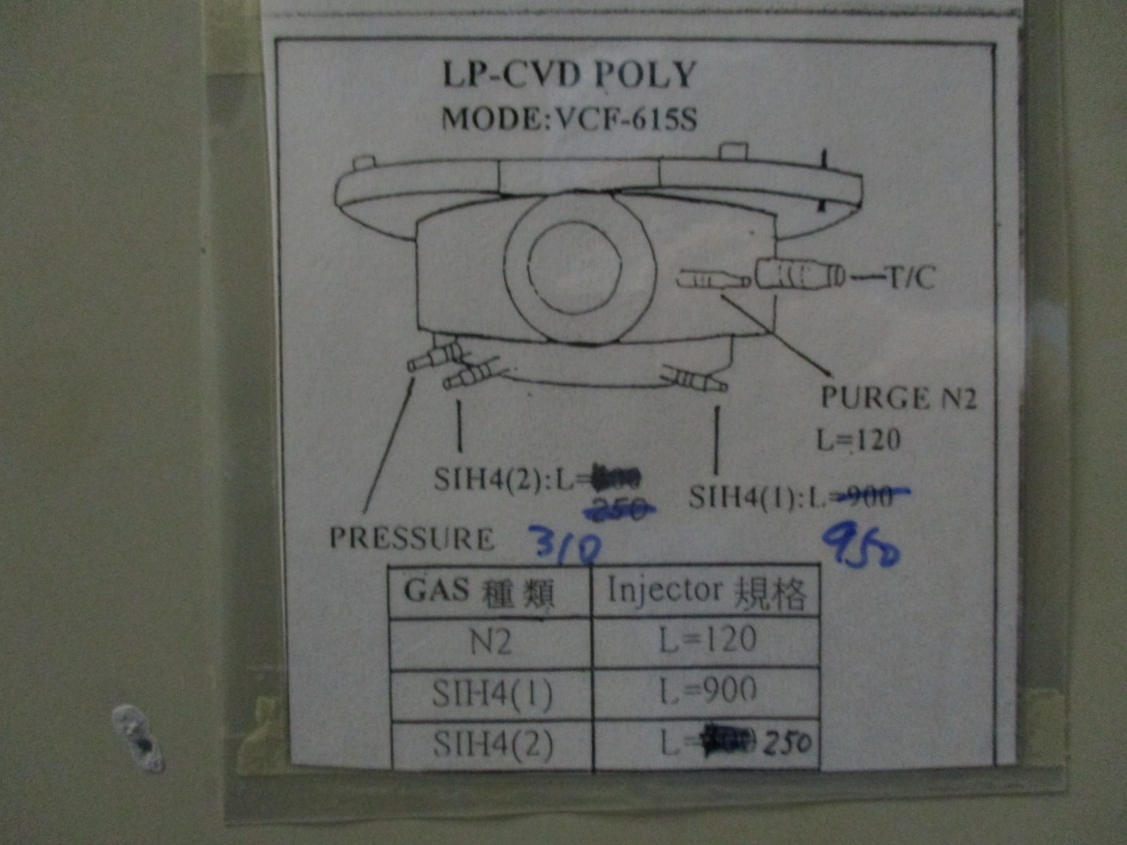
LP管
Nitride
Teos
Poly

Slide 5
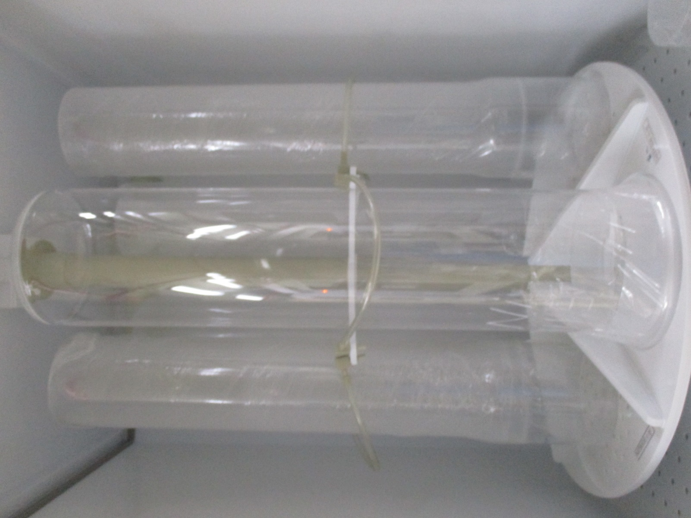
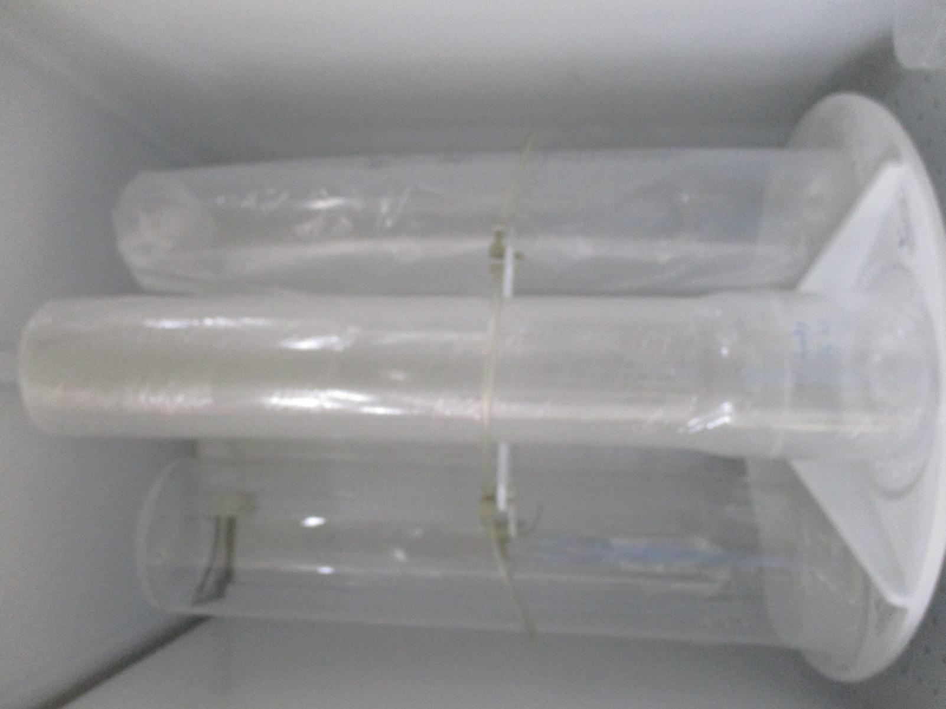
Nitride
外管C301321
內管C301322(有腰)

Slide 6
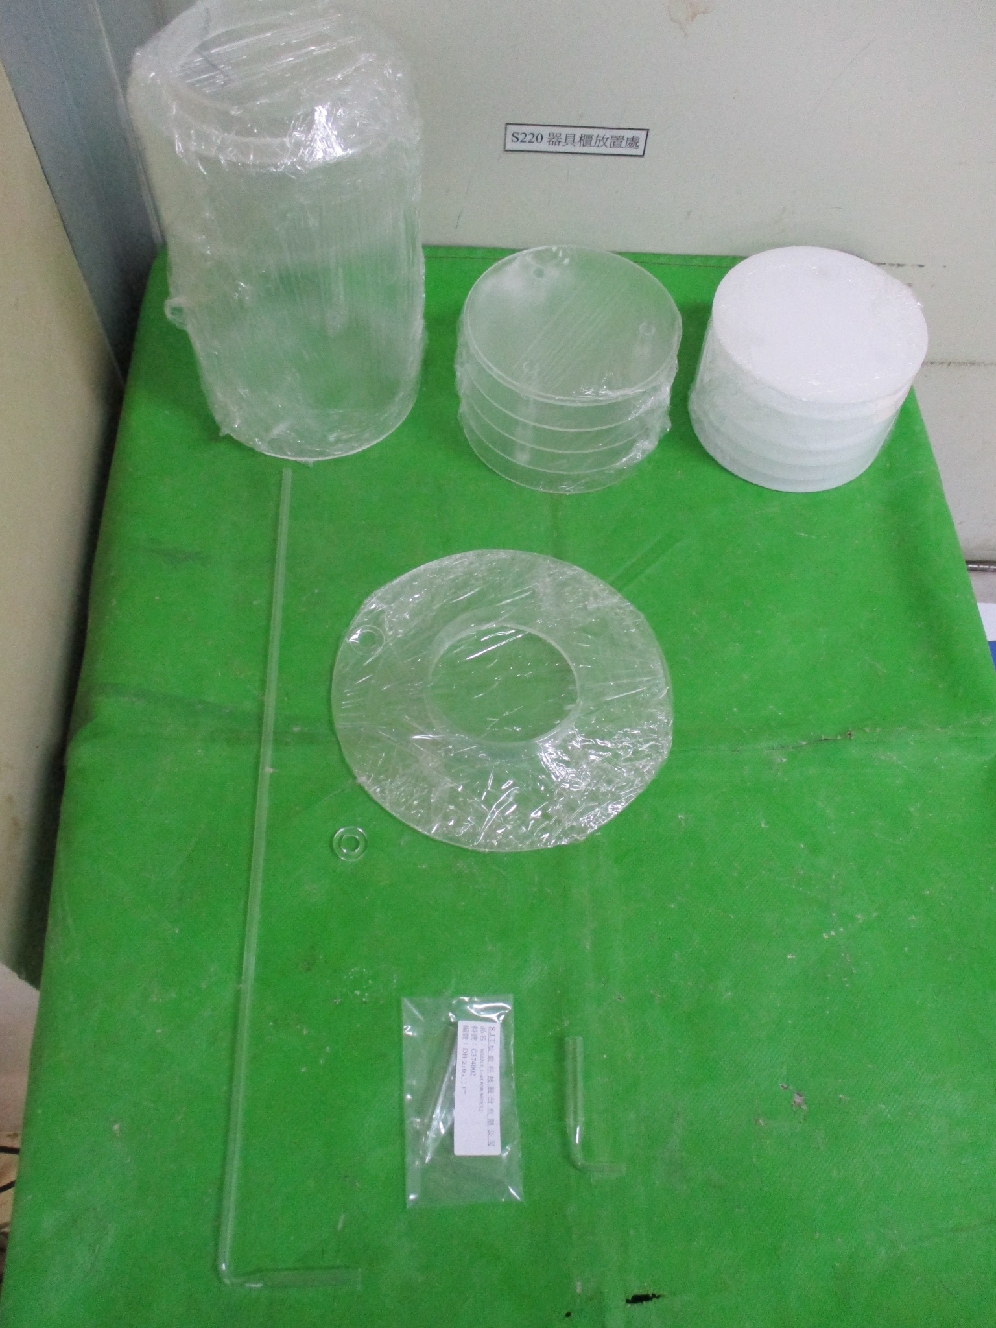
1.PEDESTAL 5FIN
2. PEDESTAL 7FIN
3.DUST TRAY
4. PEDESTAL COVER
5.T/C PORT COVER
6.NOZZLE L=25
7.NOZZLE L=45
8.NOZZLE L=500
4
1
2
3
5
6
7
8

Slide 7
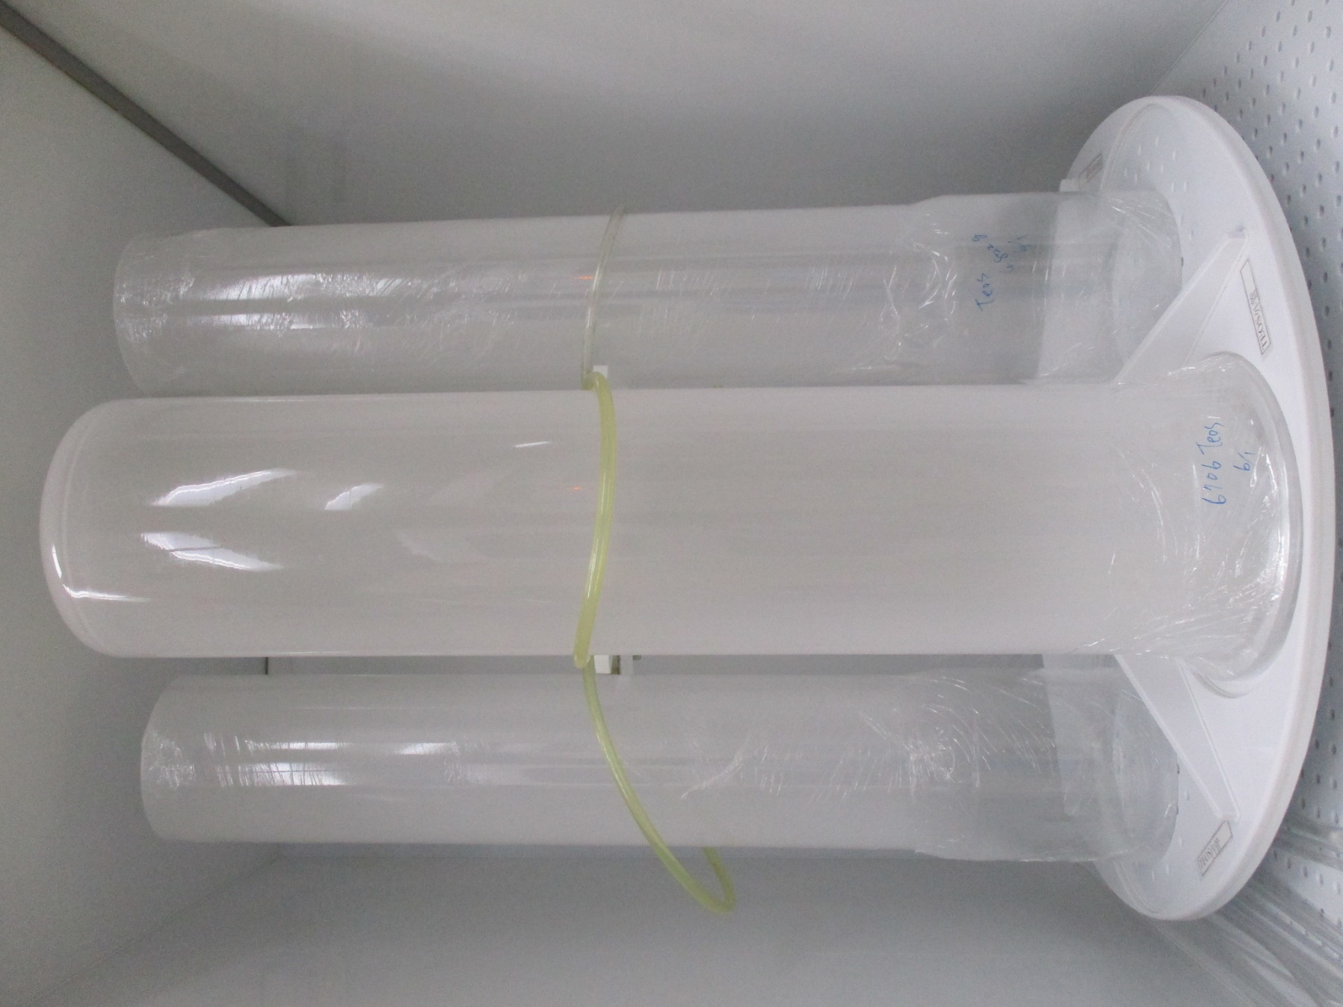
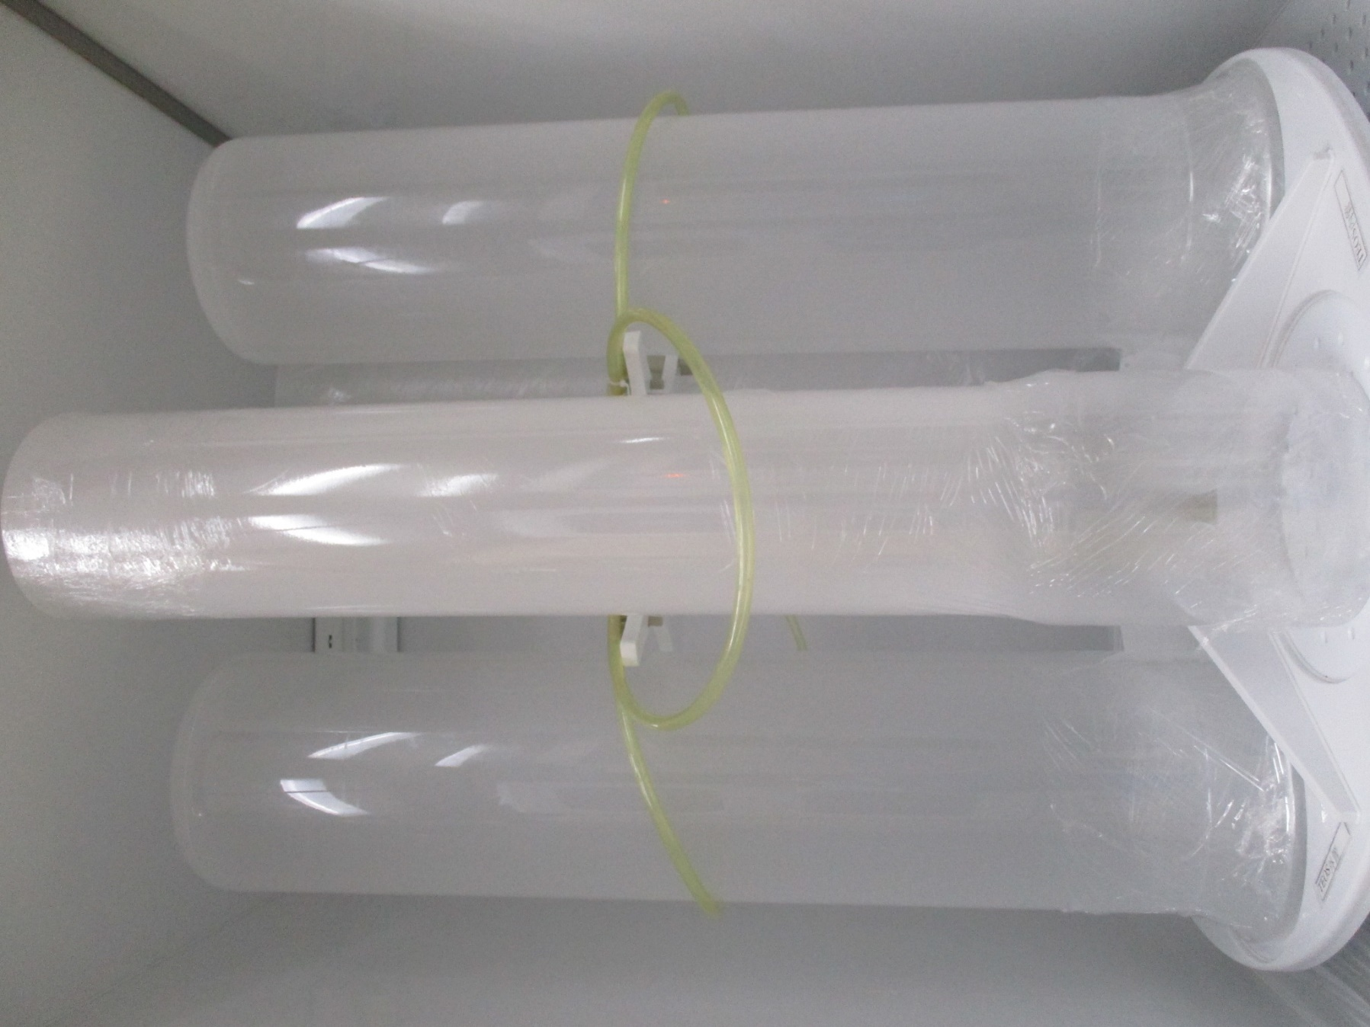
Teos
外管C301321
內管C301322(有腰)

Slide 8
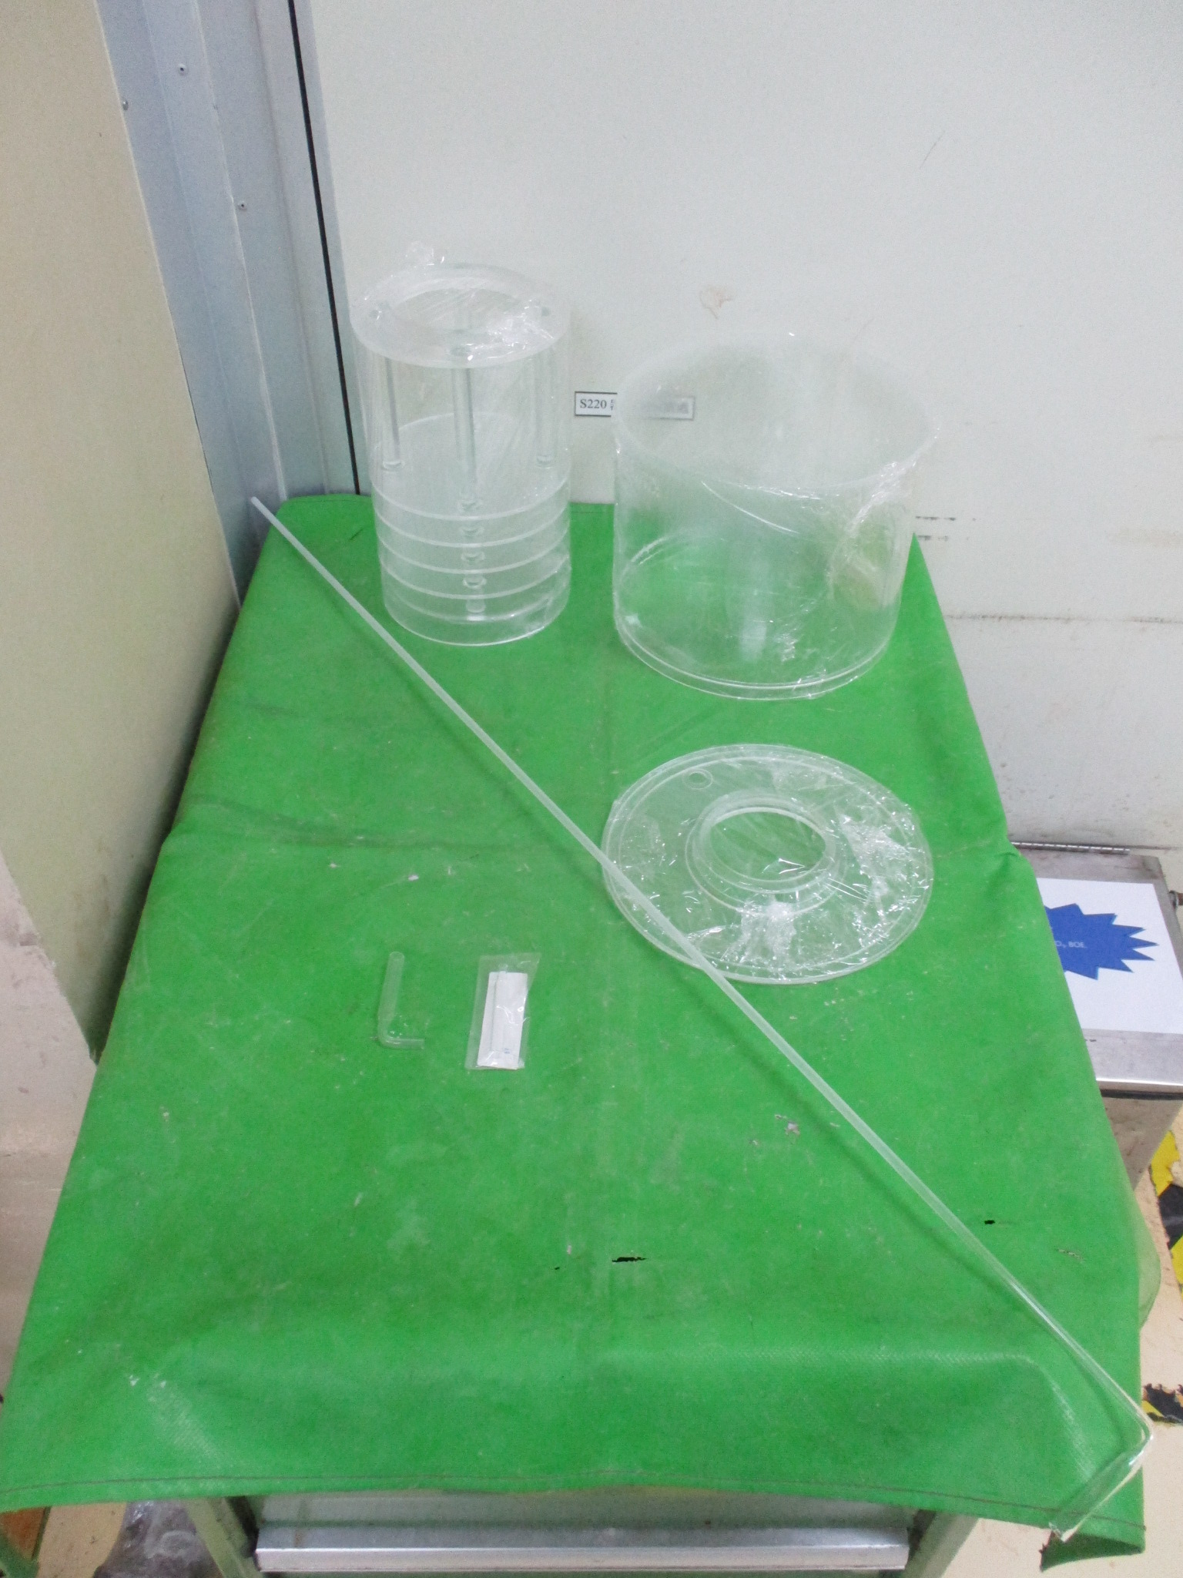
1.PEDESTAL
2. Mainfold COVER
3.DUST TRAY
4.NOZZLE L=1000
5.NOZZLE L=25
6.NOZZLE L=平口
1
2
3
5
6
4

Slide 9
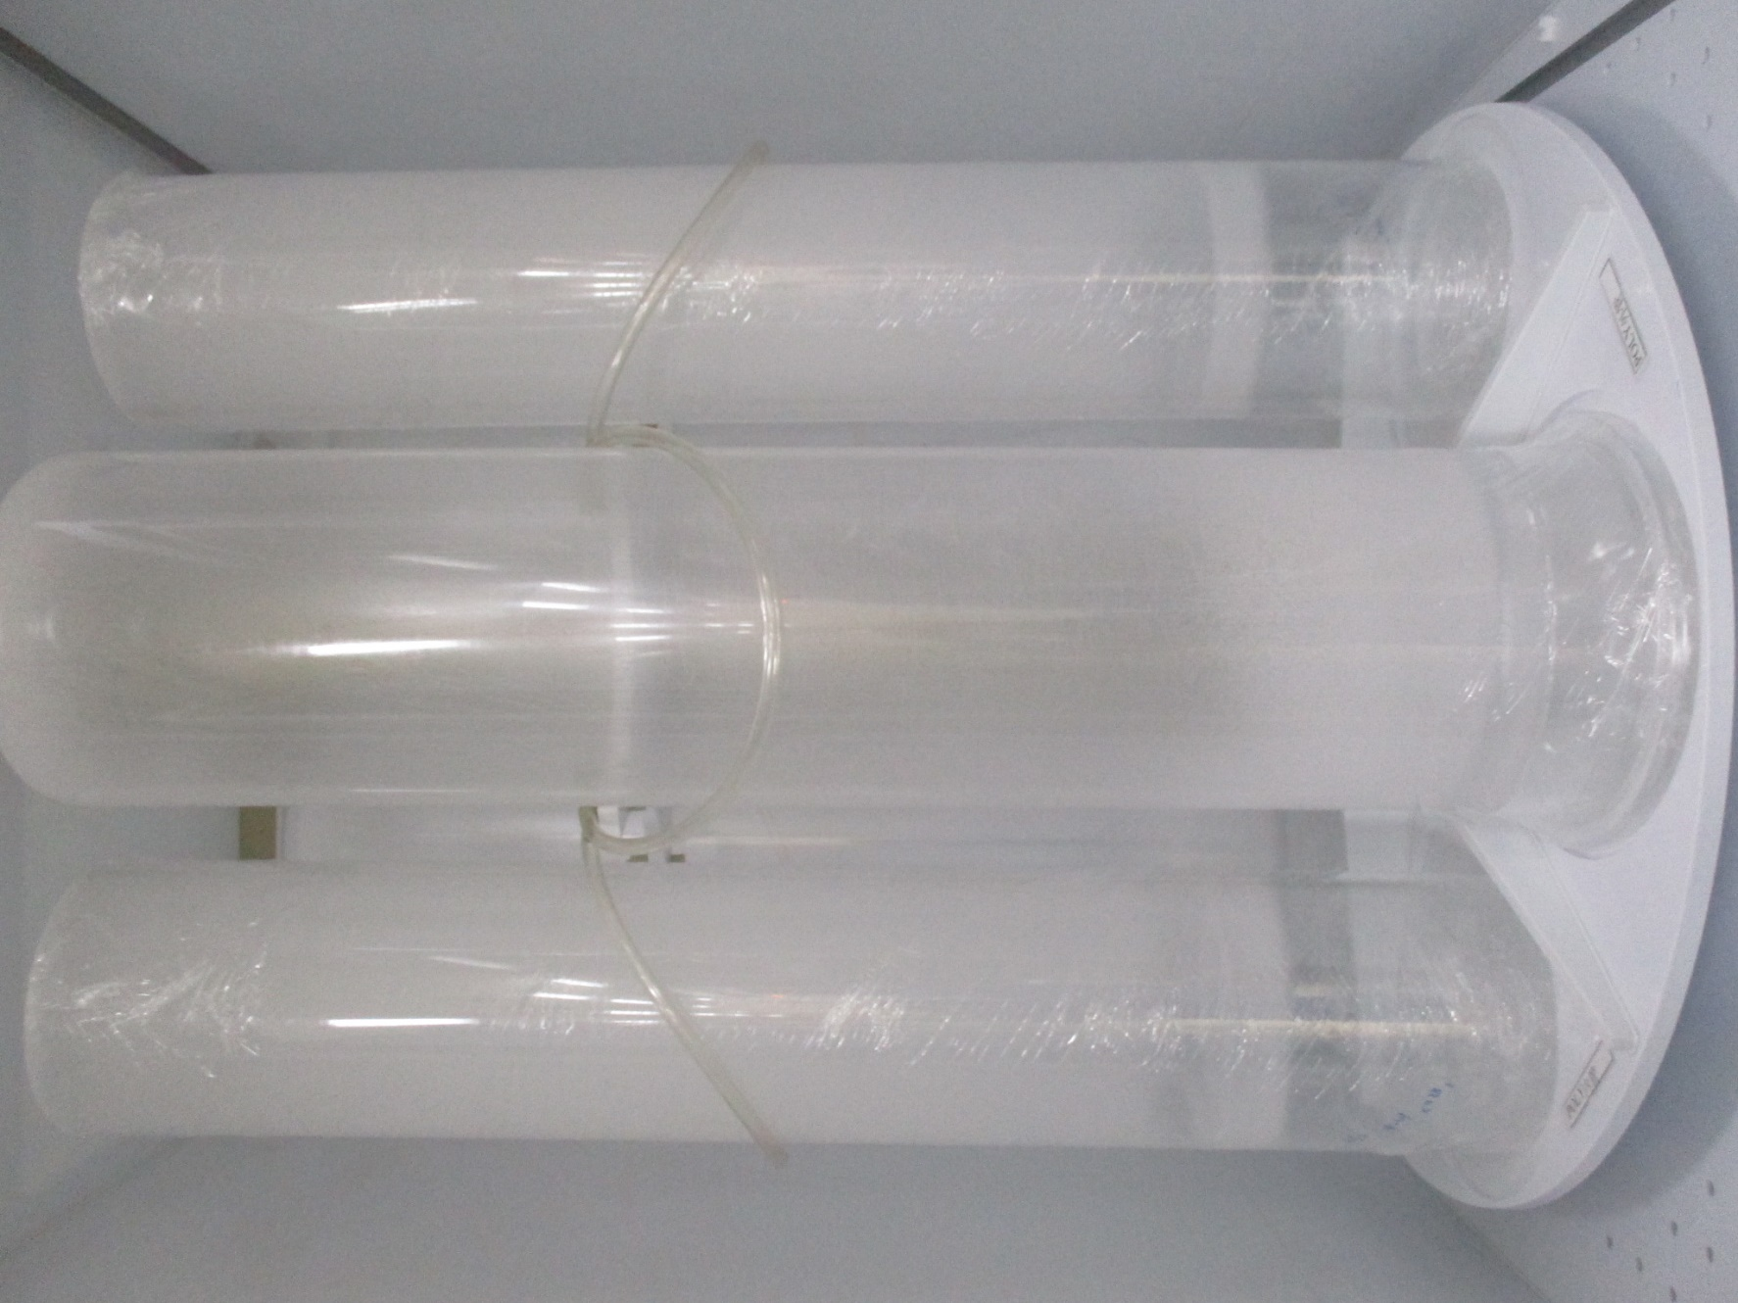
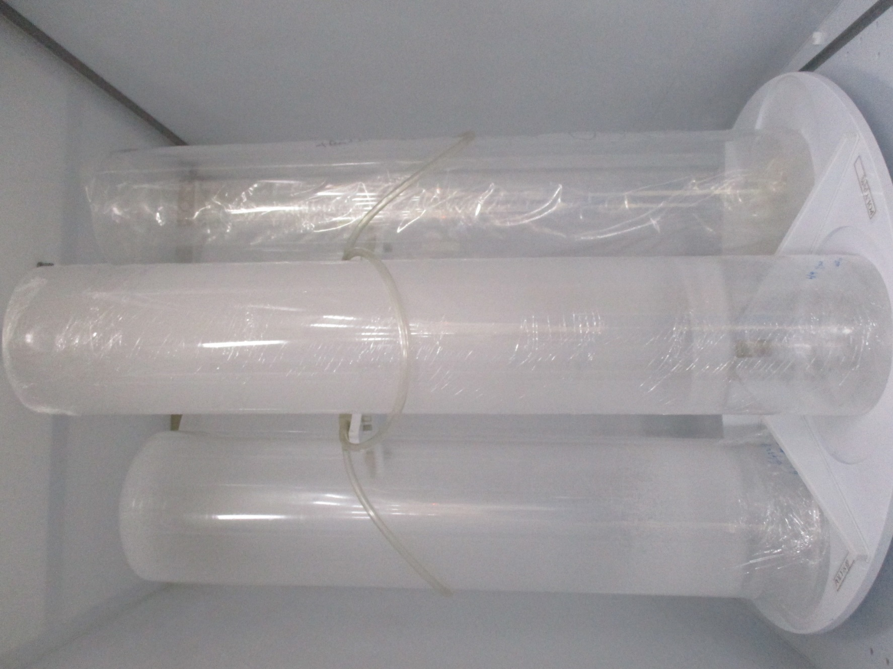
Poly
外管
內管(無腰)

Slide 10
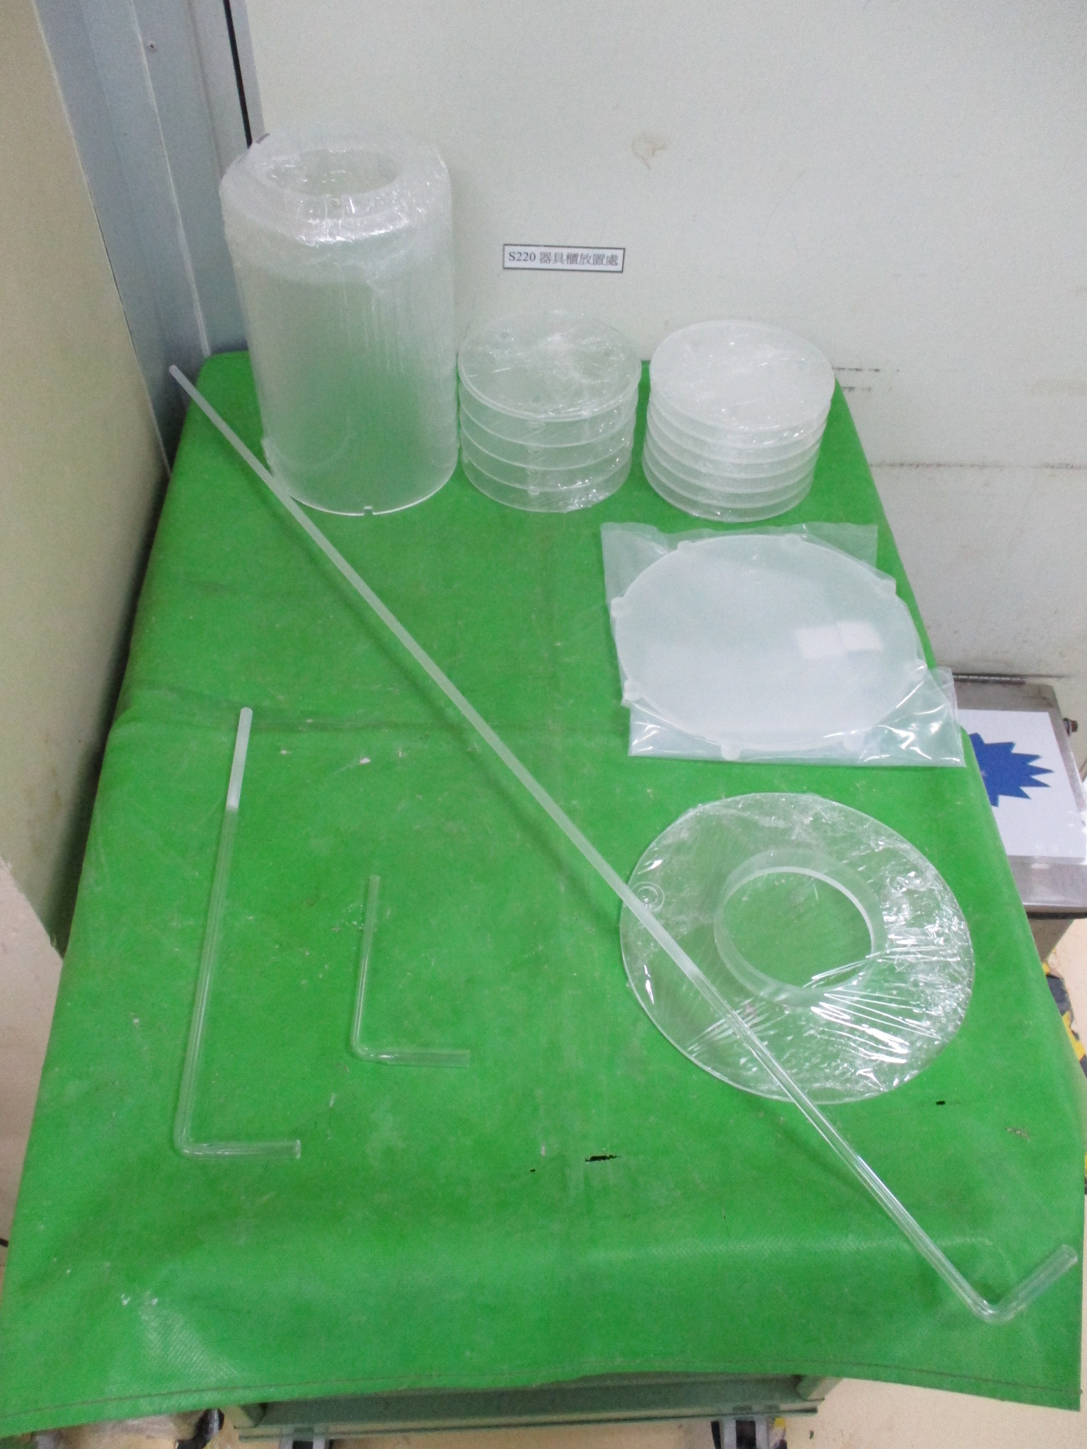
1.PEDESTAL 5FIN
2. PEDESTAL 7FIN
3.DUST TRAY
4. PEDESTAL COVER
5.SHUTTER PLATE
6.NOZZLE L=950
7.NOZZLE L=310
8.NOZZLE L=120
4
1
2
5
6
3
7
8

Slide 11
AP管
Oxide
POCL
ALLOY
雙層
單層
單層

Slide 12
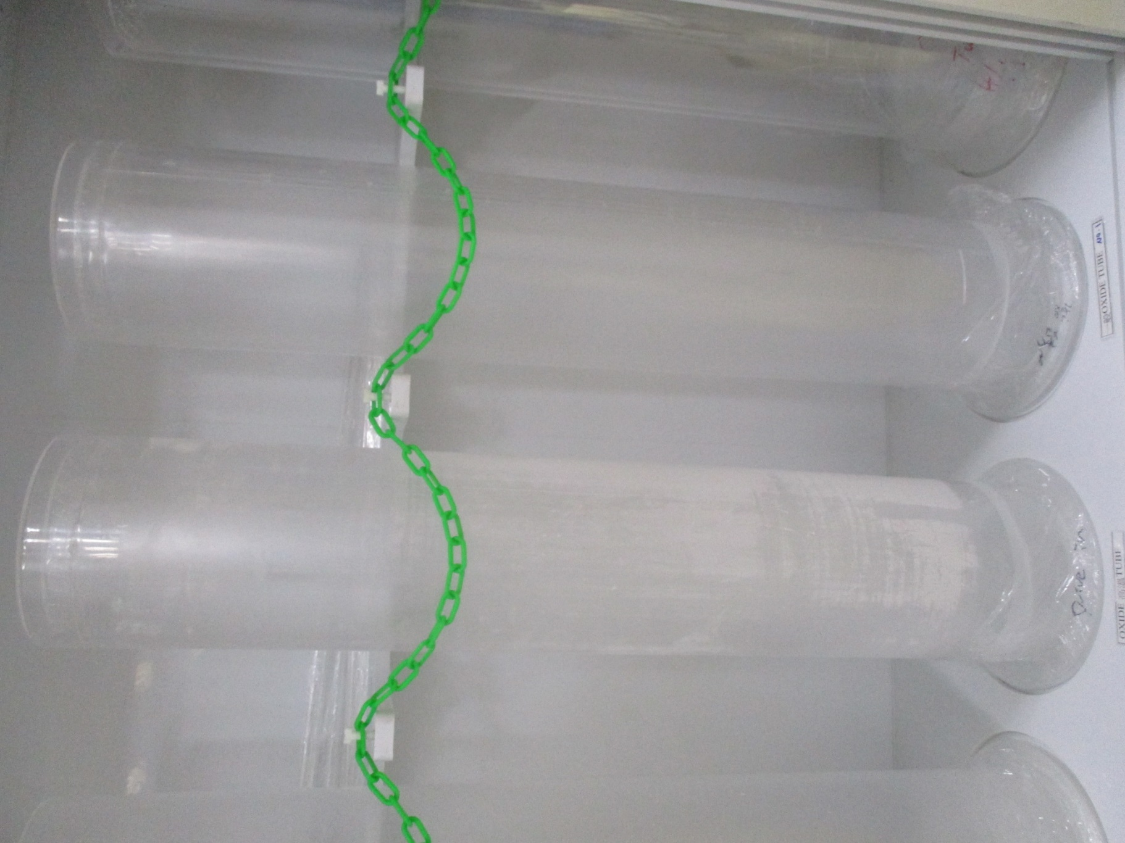
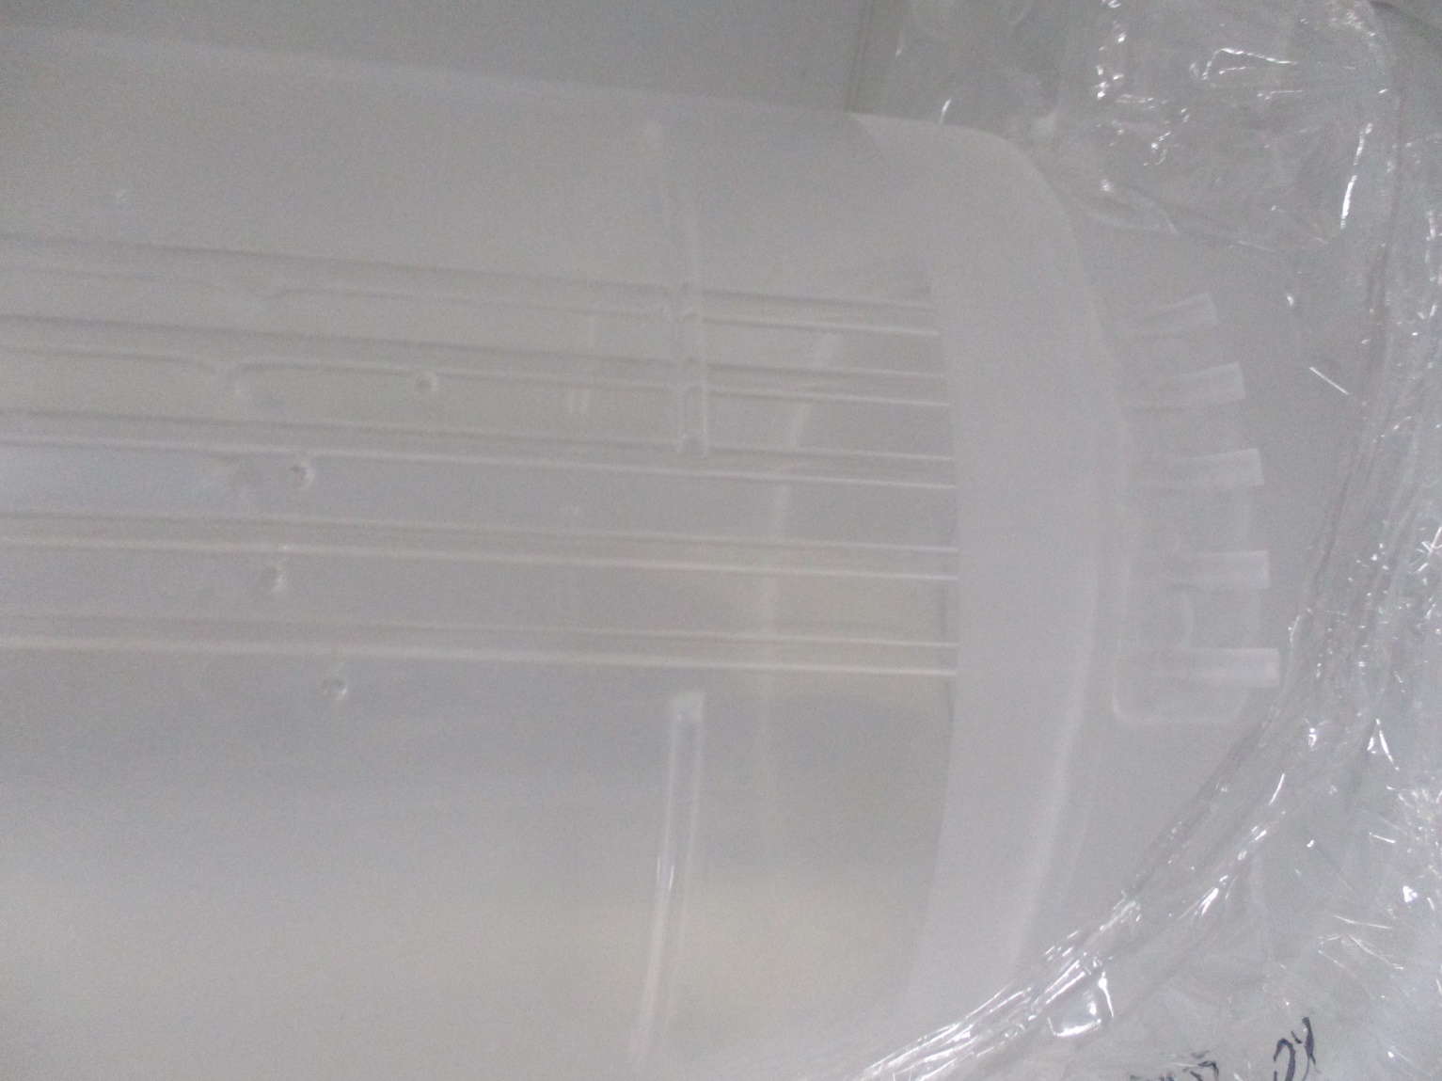
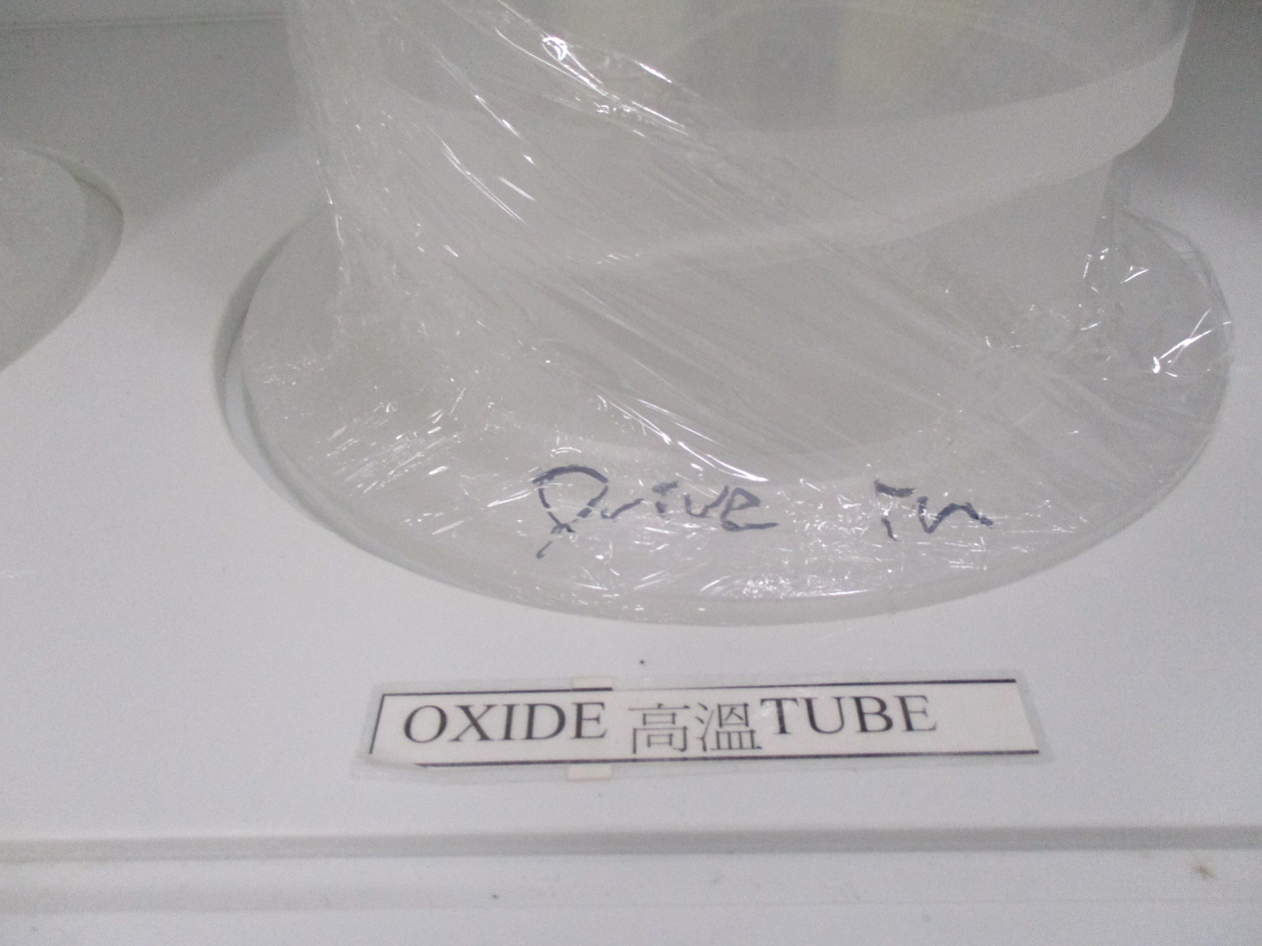
Oxide
分4孔 & 7孔
高溫Drive in 無 T/C
一般Oxide管有T/C

Slide 13
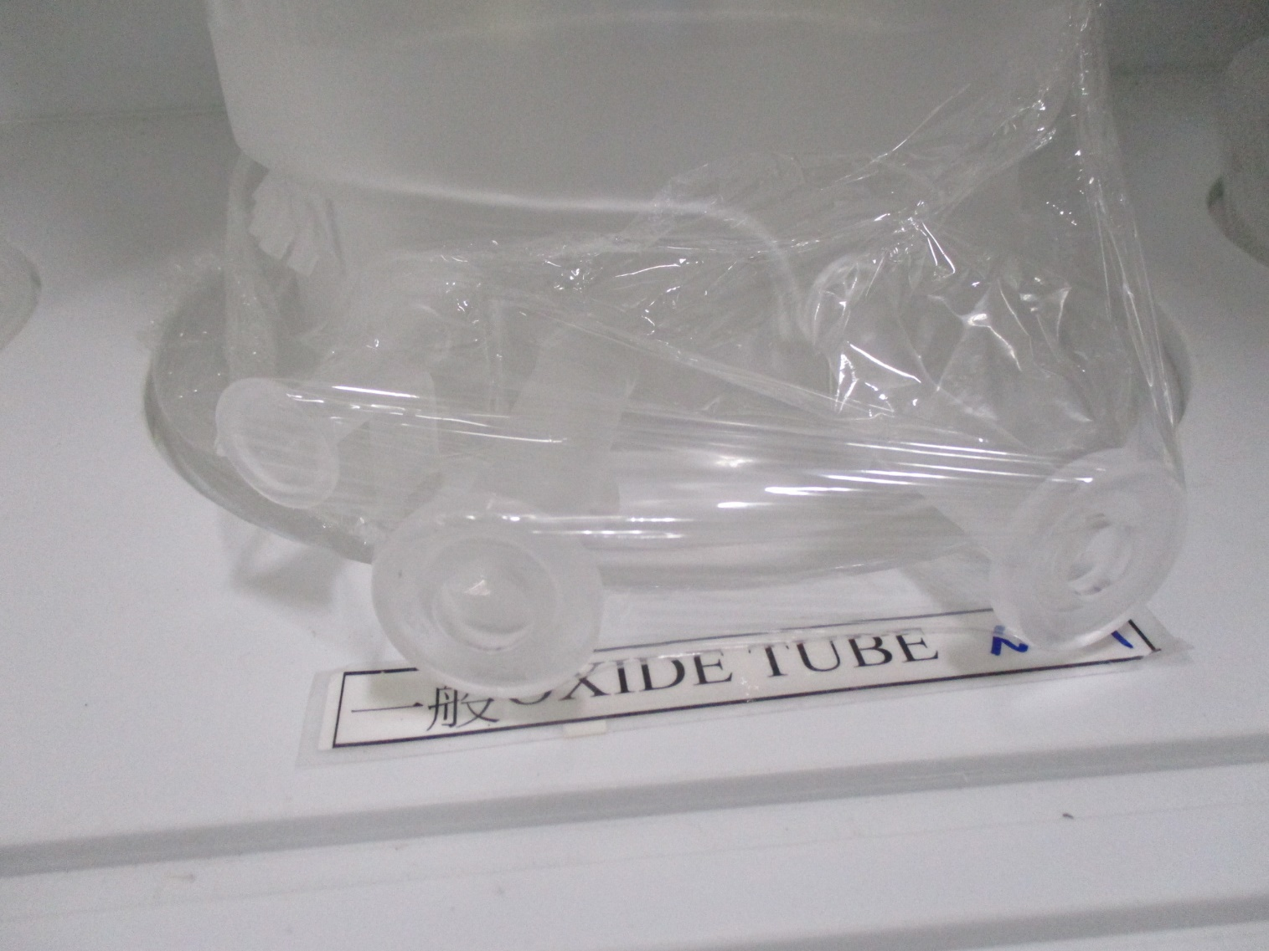
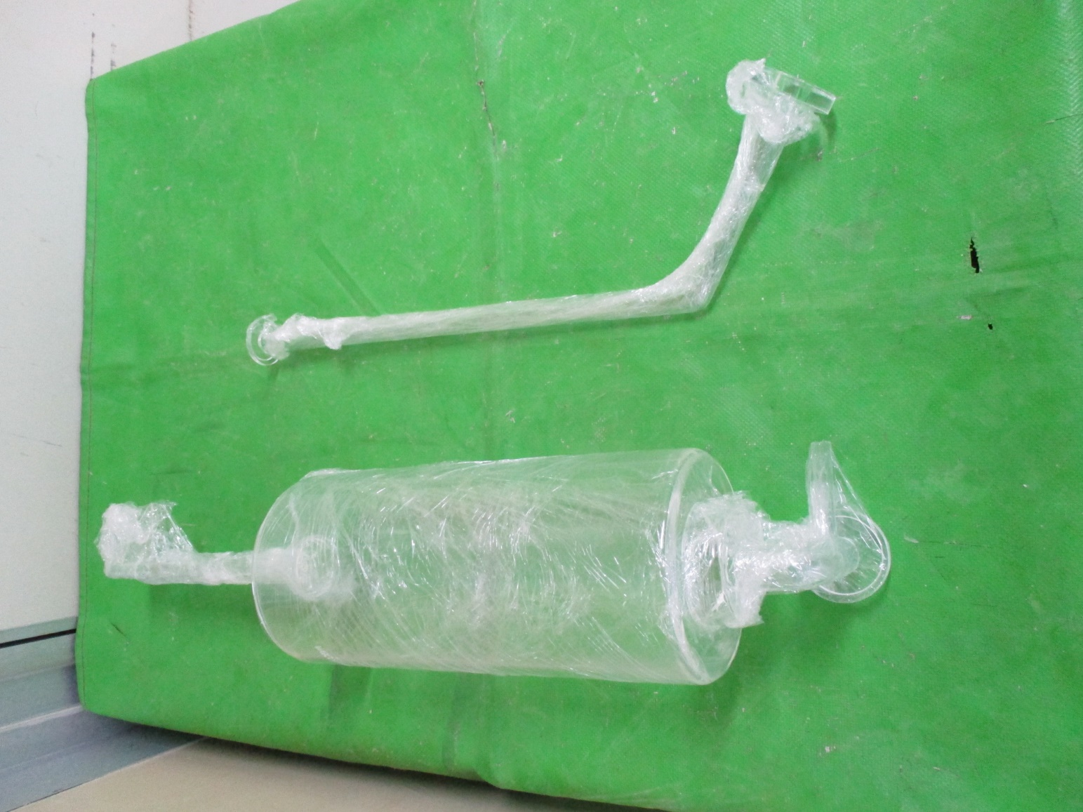
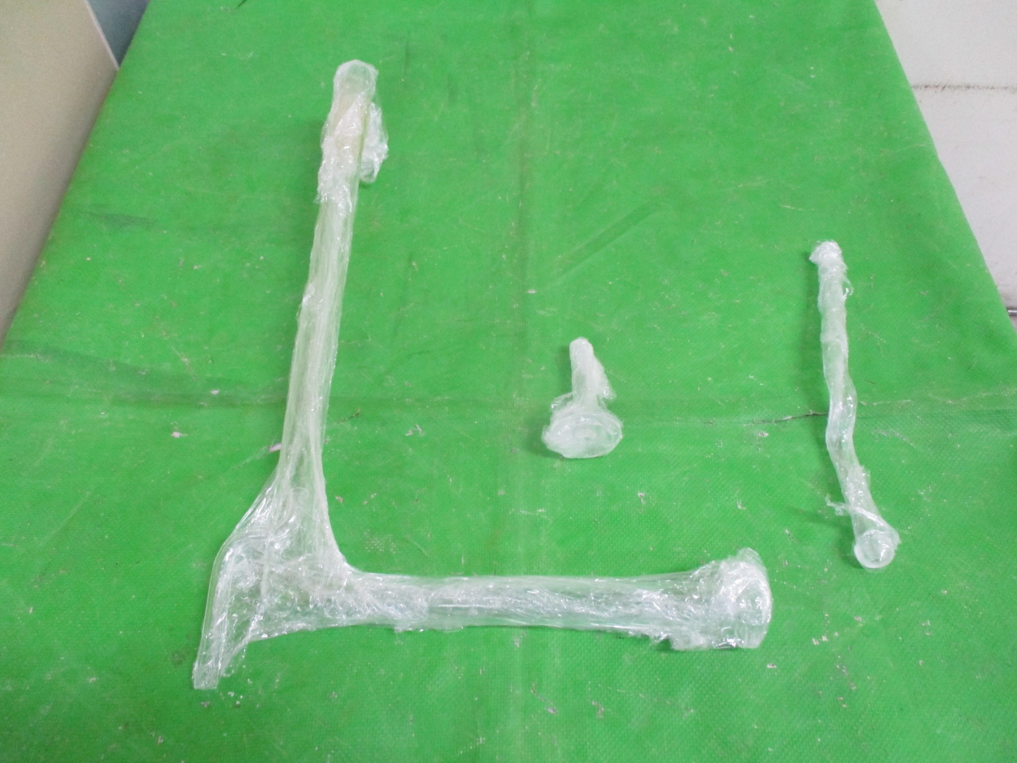
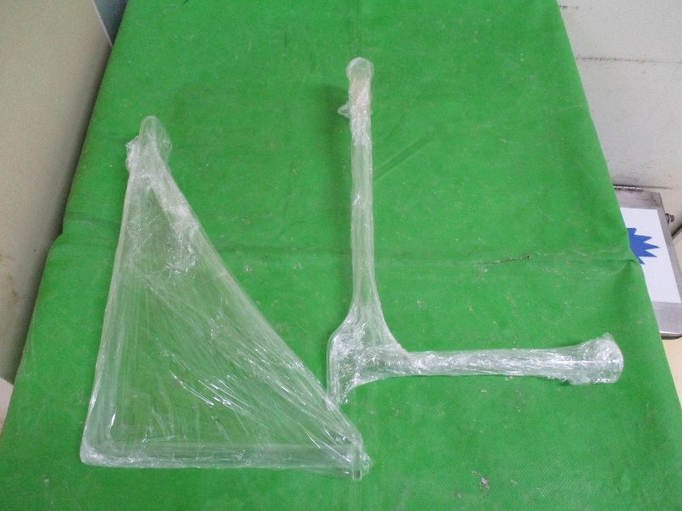
喇叭頭
Inlet
Exhuast
Torch
Torch Piping
香菇頭
Exhuast Piping

Slide 14
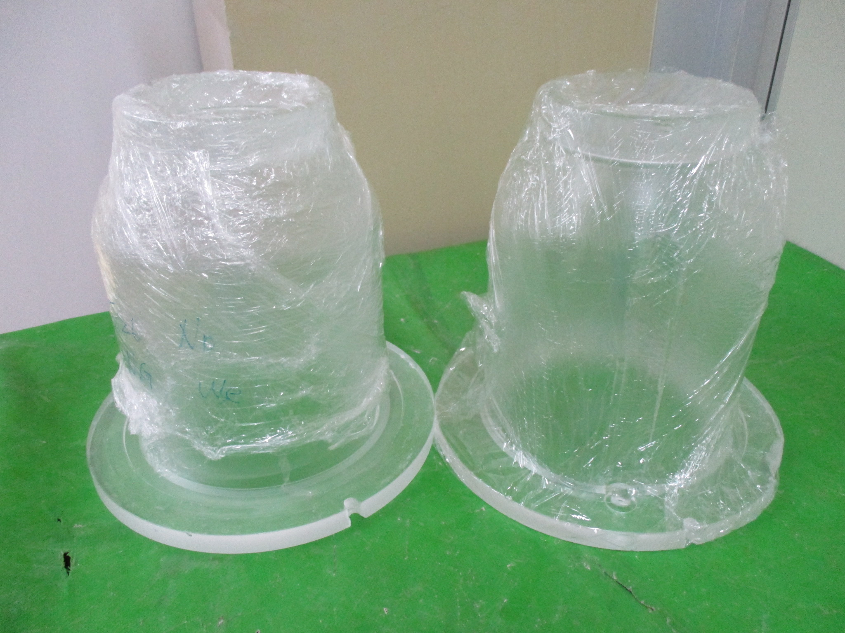
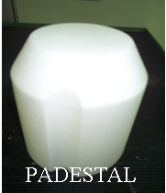
有孔Pedestal Cover
高溫Drive in校溫時用 校溫完需換回無孔
無孔Pedestal Cover

Slide 15
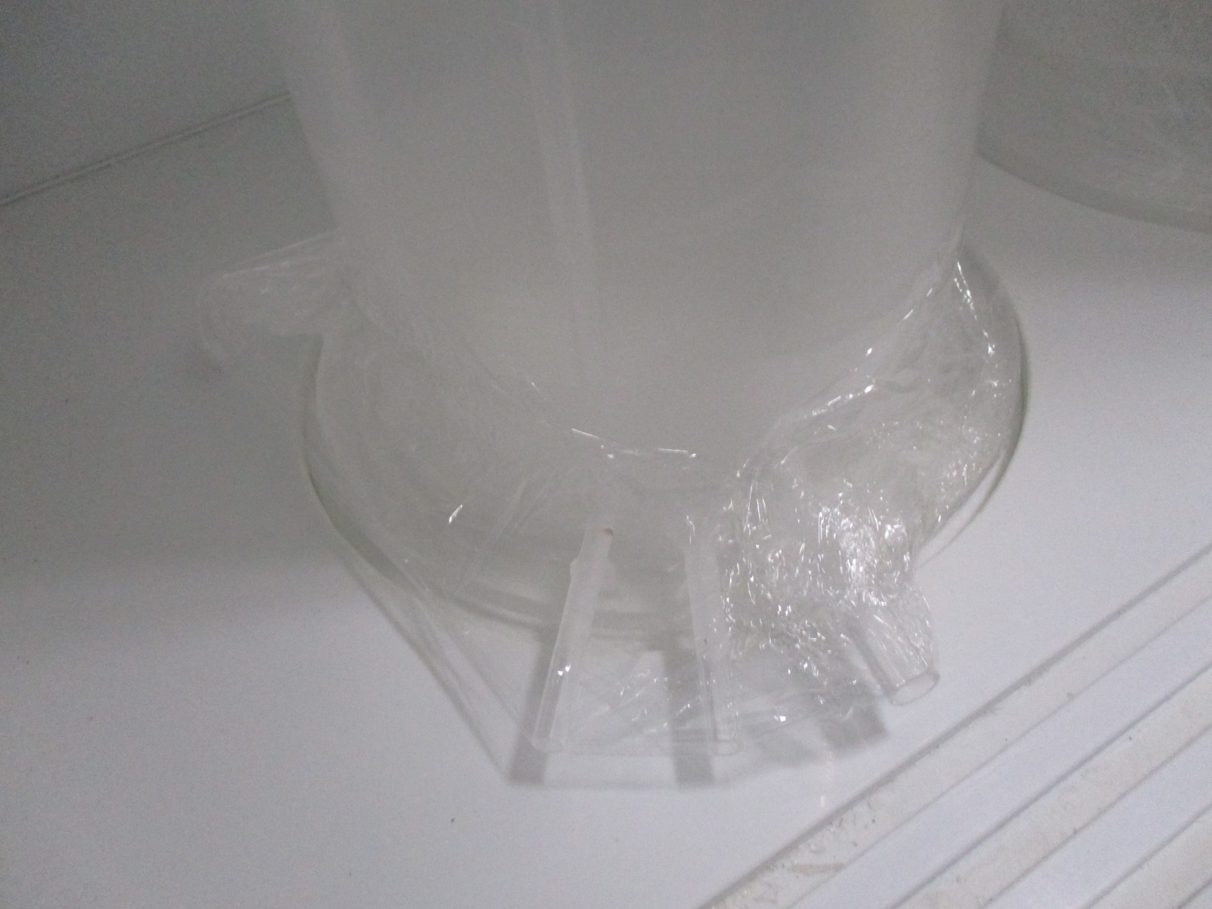
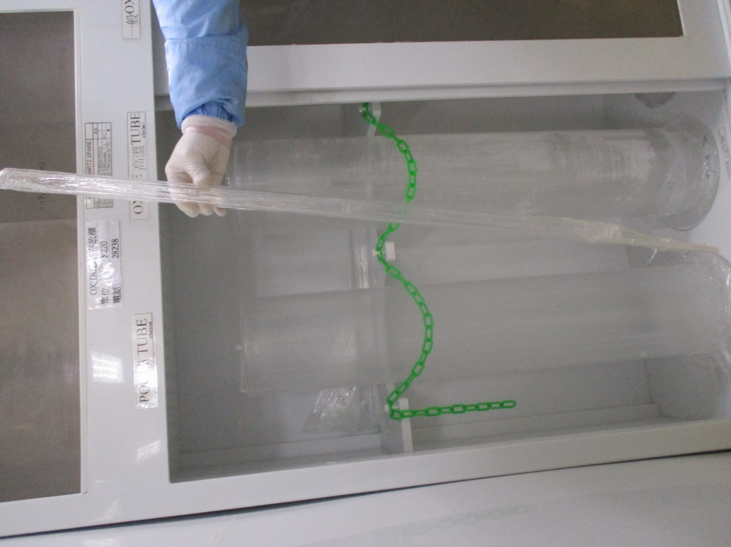
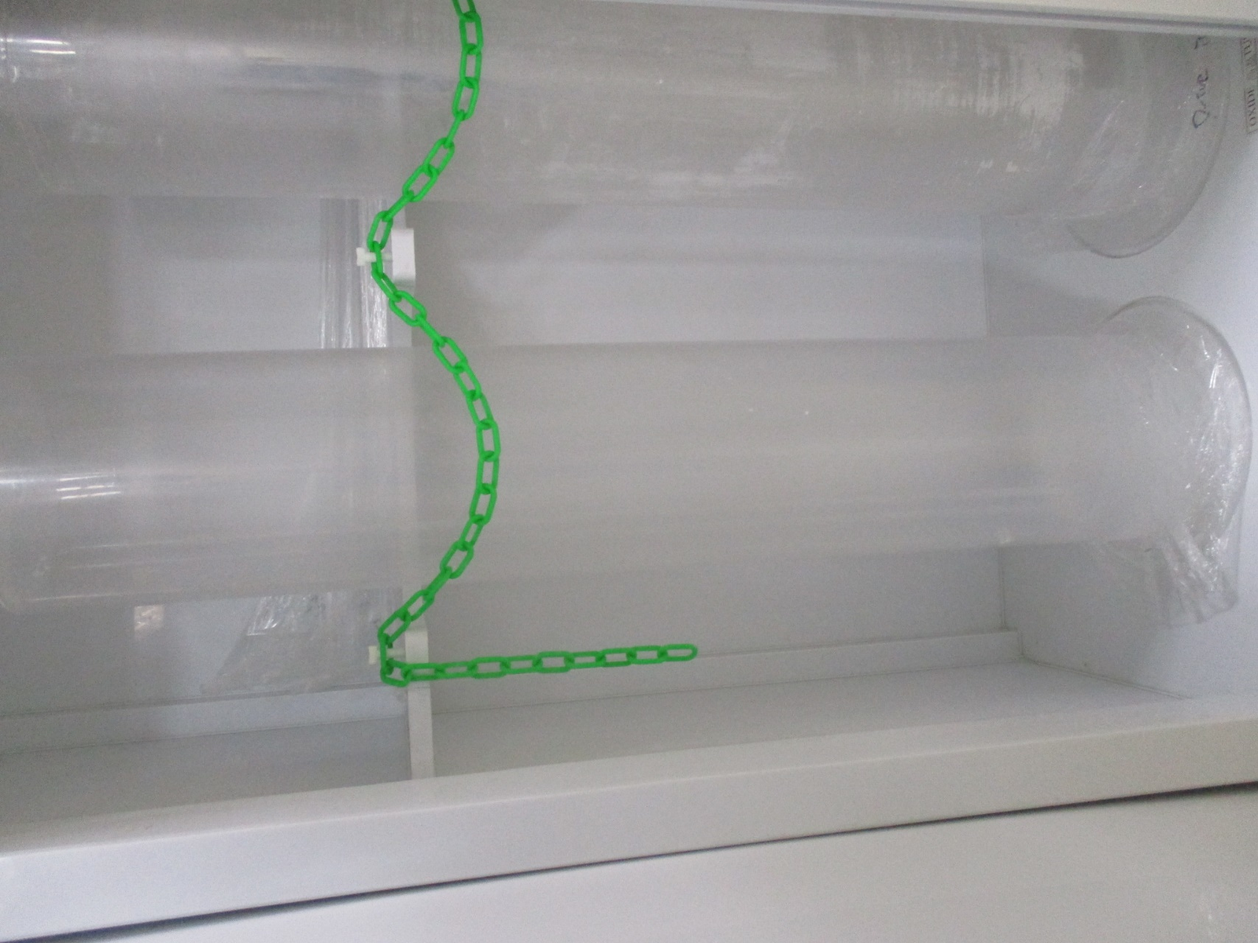
POCL
Exhaust
T/C

Slide 16
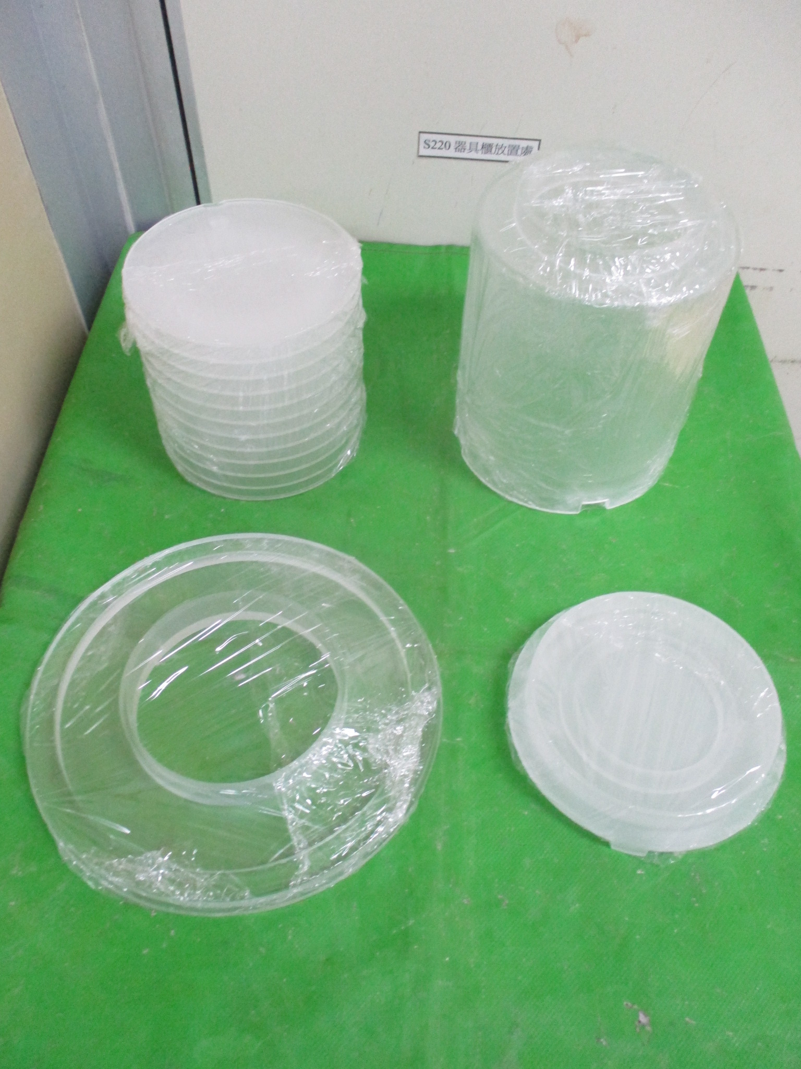
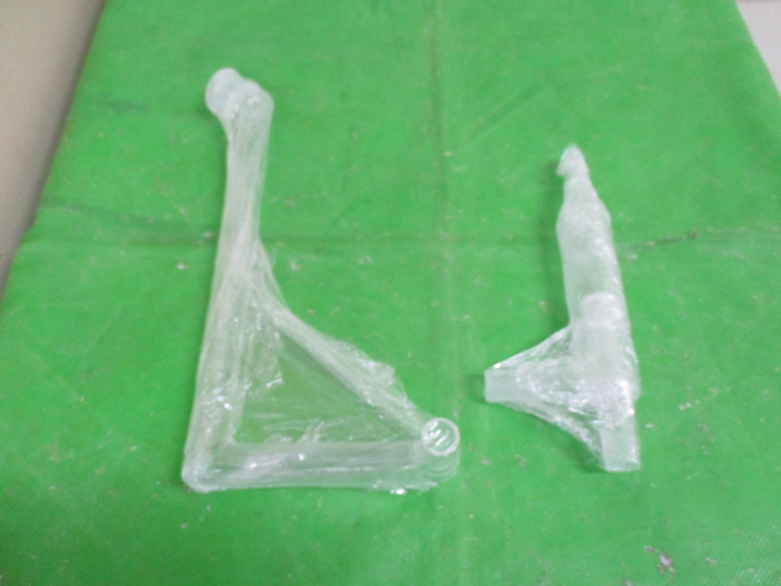
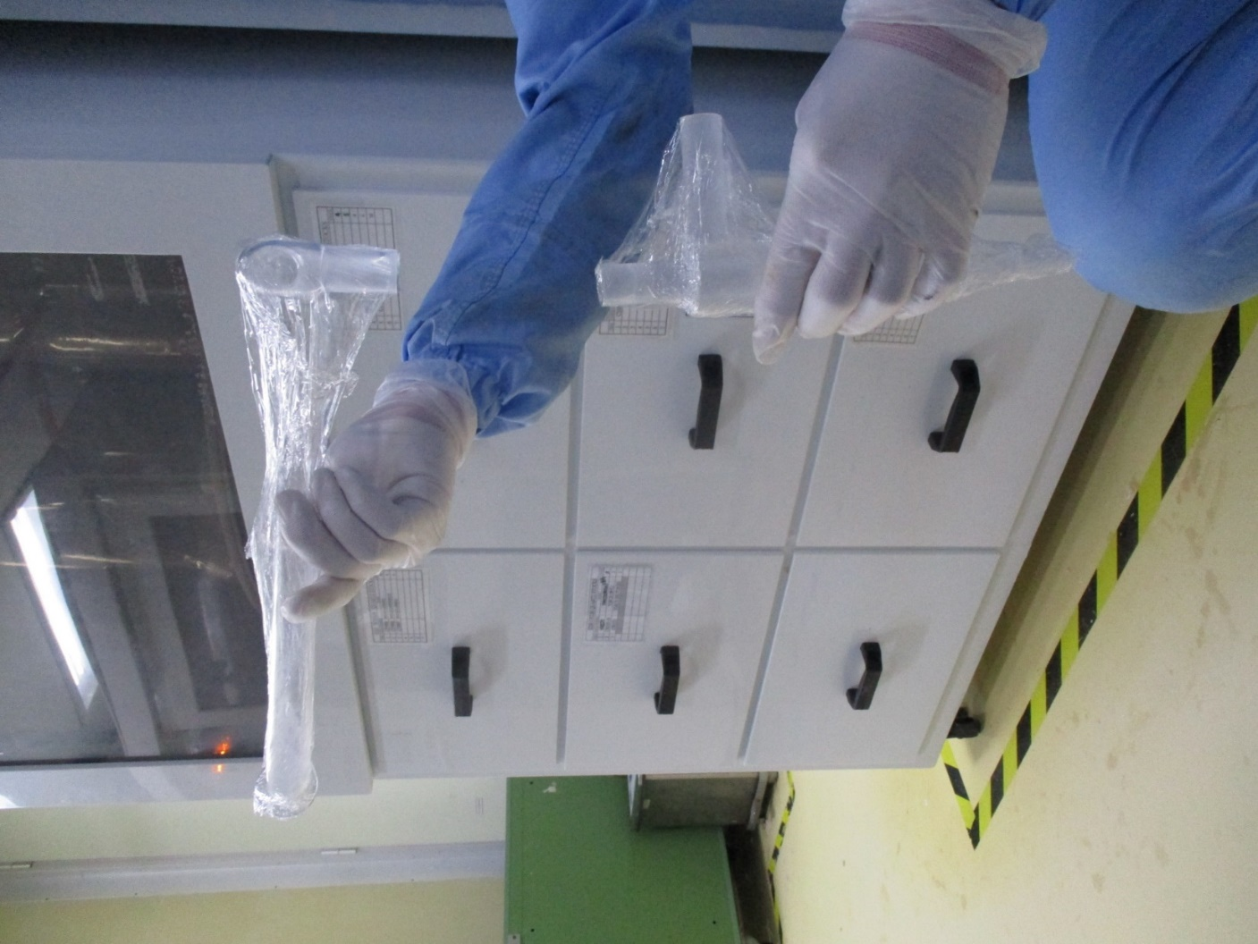
Pedestal 12FIN
Exhuast Piping
Pedestal cover
菸斗
Pedestal Base
Bust tray

Slide 17
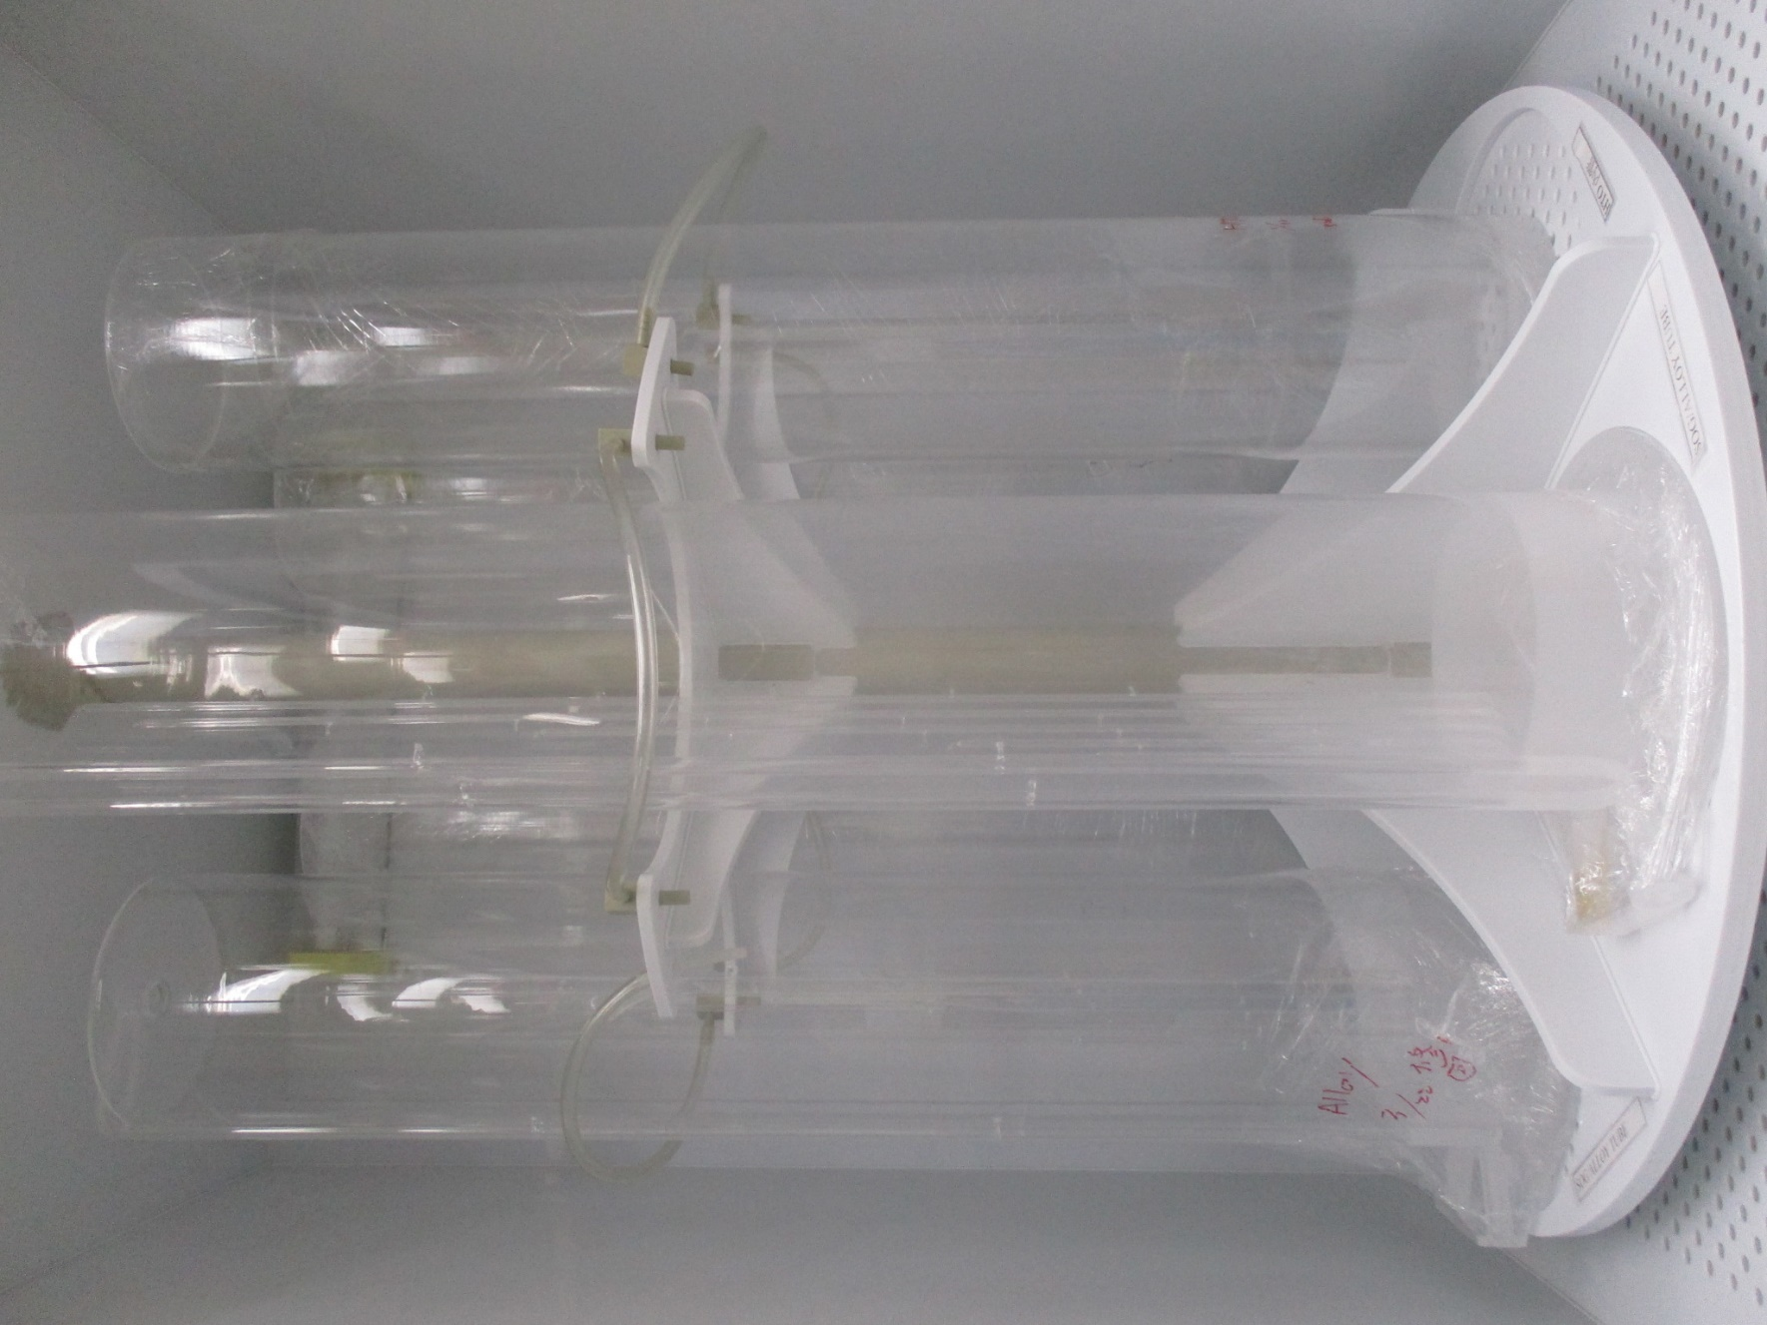
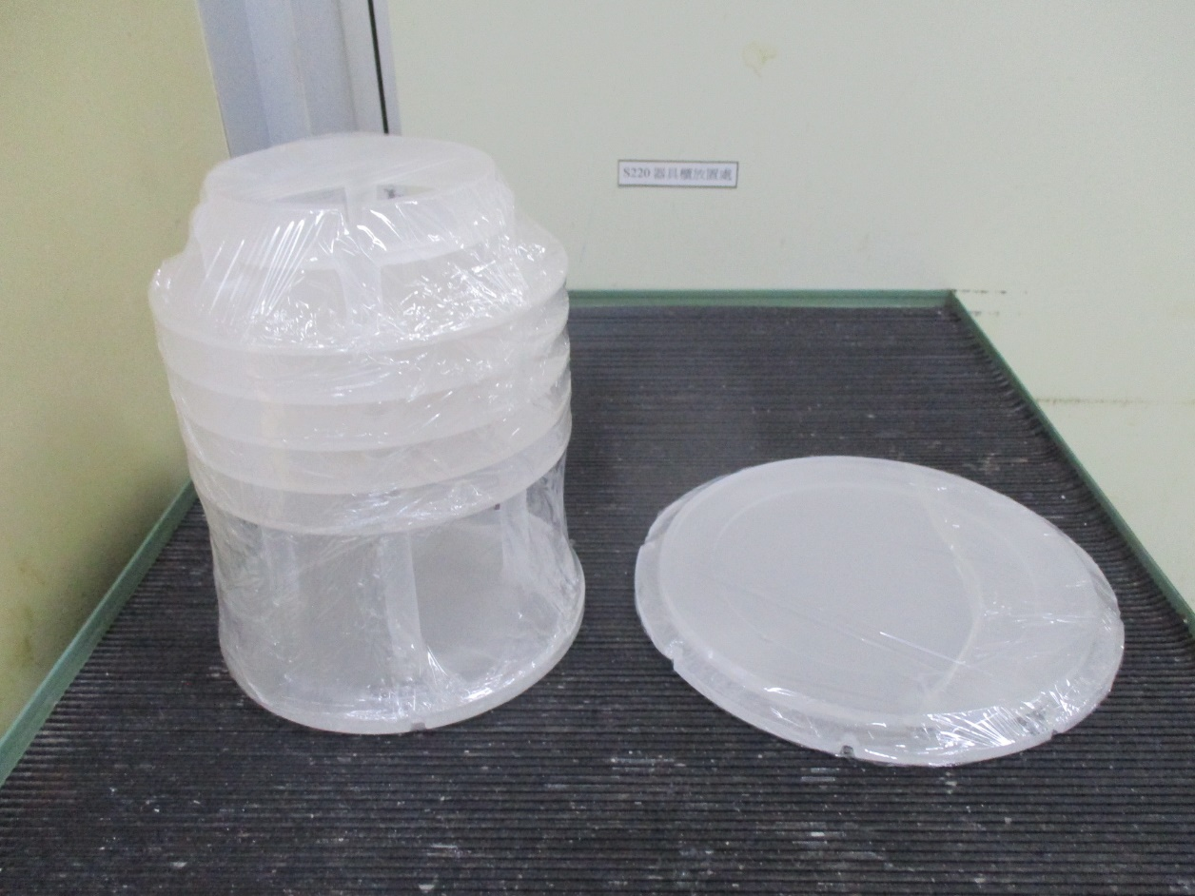
ALLOY
ALLOY管
主要用於升溫回火用
GAS connect piping
Pedestal(ALLOY)
Pedestal Base
Exhuast Piping(ALLOY)

Slide 18
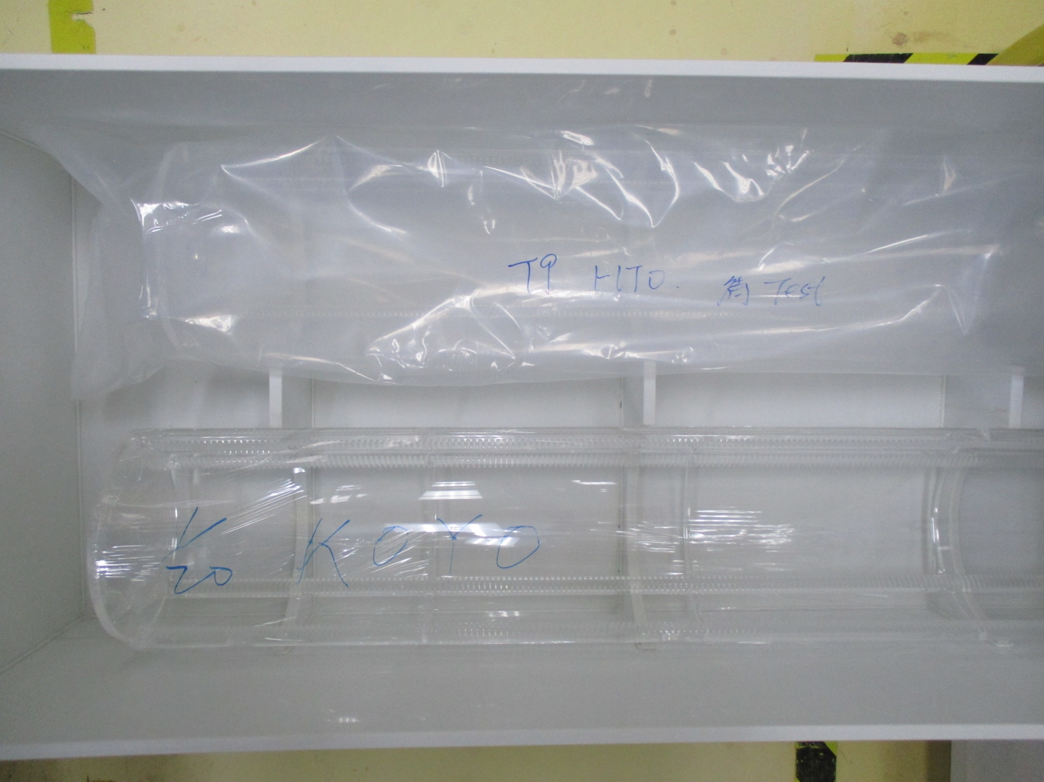
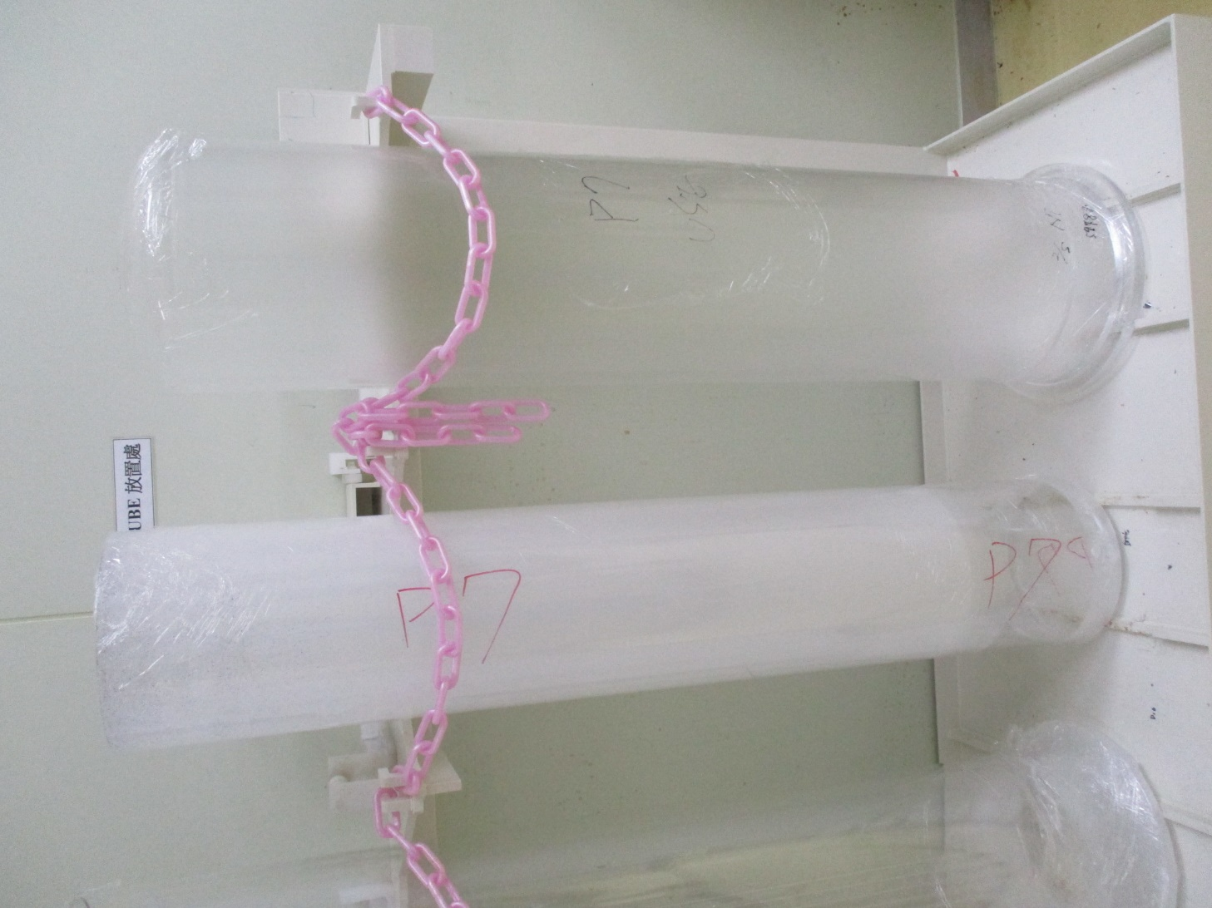
P7用內、外管
(較老舊之內外管)
T9 HTO BOAT
KOYO BOAT

Slide 19
